Slide 1
Capstone Project Update
AuE-8360 Scaled Autonomous Vehicles
Chinmay Samak
PhD Candidate, CU-ICAR
csamak@clemson.edu
Tanmay Samak
PhD Candidate, CU-ICAR
tsamak@clemson.edu

Slide 2
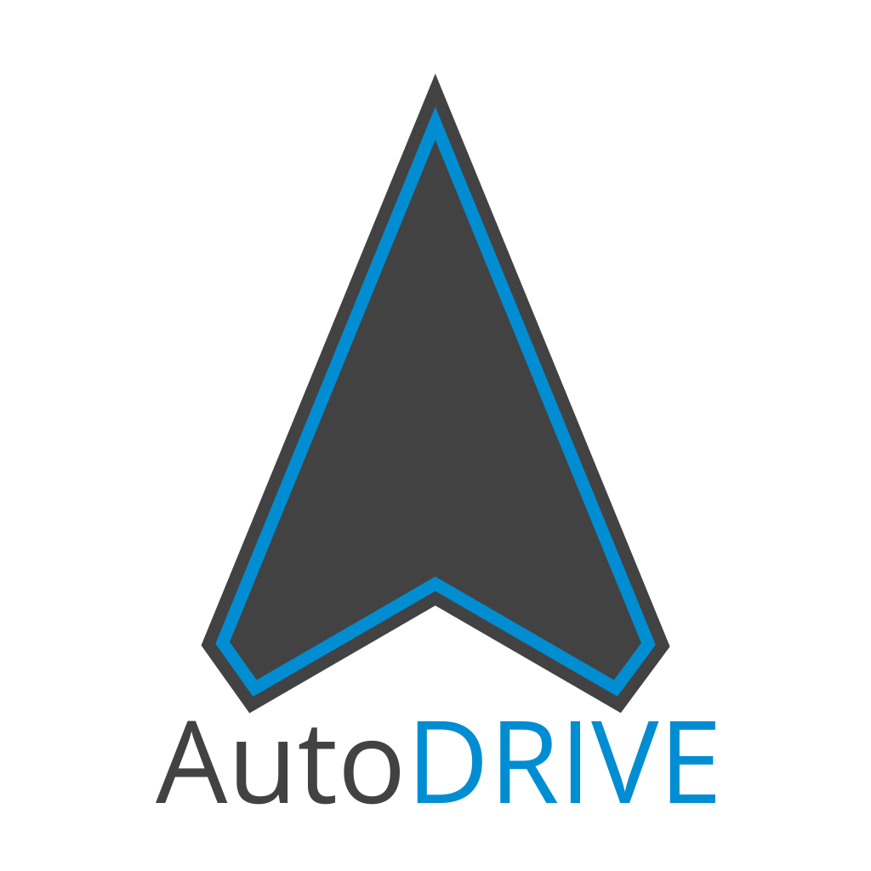



Planned Project Objectives
Theme: digital twins + vehicle scale + Autoware
ODD focus: on-road autonomous navigation
Platforms:
Small-scale: Nigel/F1TENTH
Full-scale: OpenCAV
Simulation: AutoDRIVE Simulator
Software-stack: Autoware
True digital twin framework:
Immersive teleoperation demo
Autoware demo:
Autonomous navigation (waypoint following)
Documentation

Slide 3
Planned Project Objectives
AuE-8360 Capstone Project (Fall 2023)
Task | 10/18 | 10/25 | 11/01 | 11/08 | 11/15 | 11/22 | 11/29 | 12/06
Announcements
Project Proposal
Phase 1
Phase 2
Phase 3
Project Presentation
Project Report

Slide 4
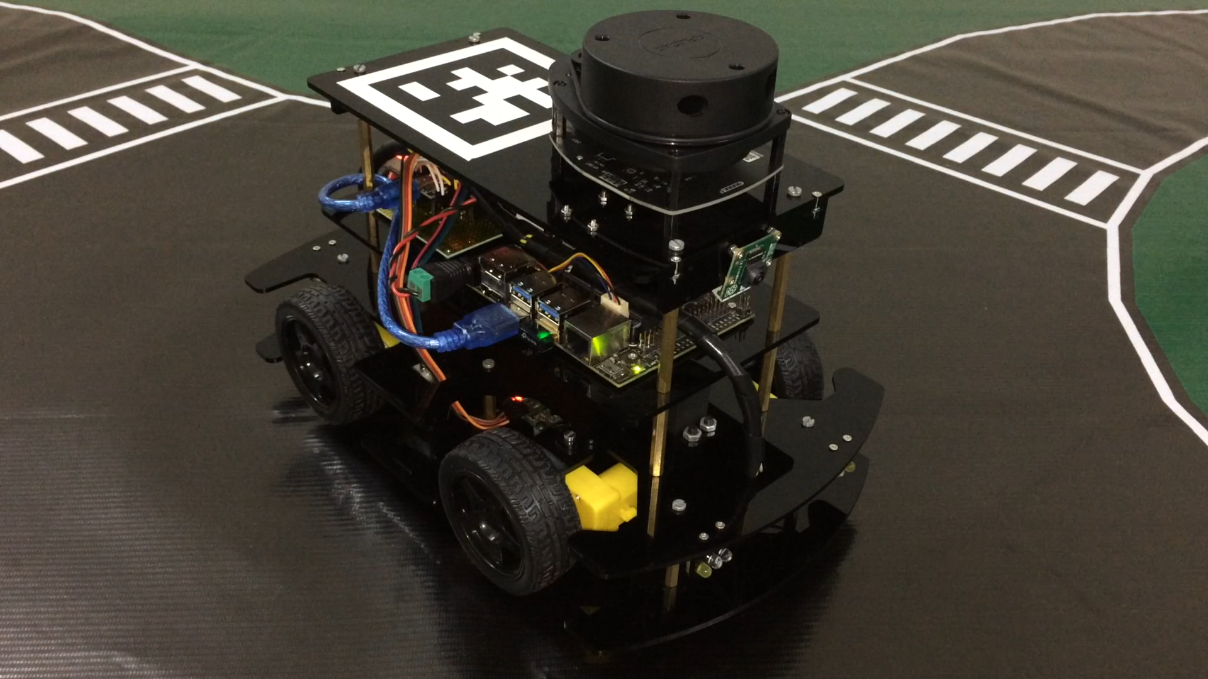
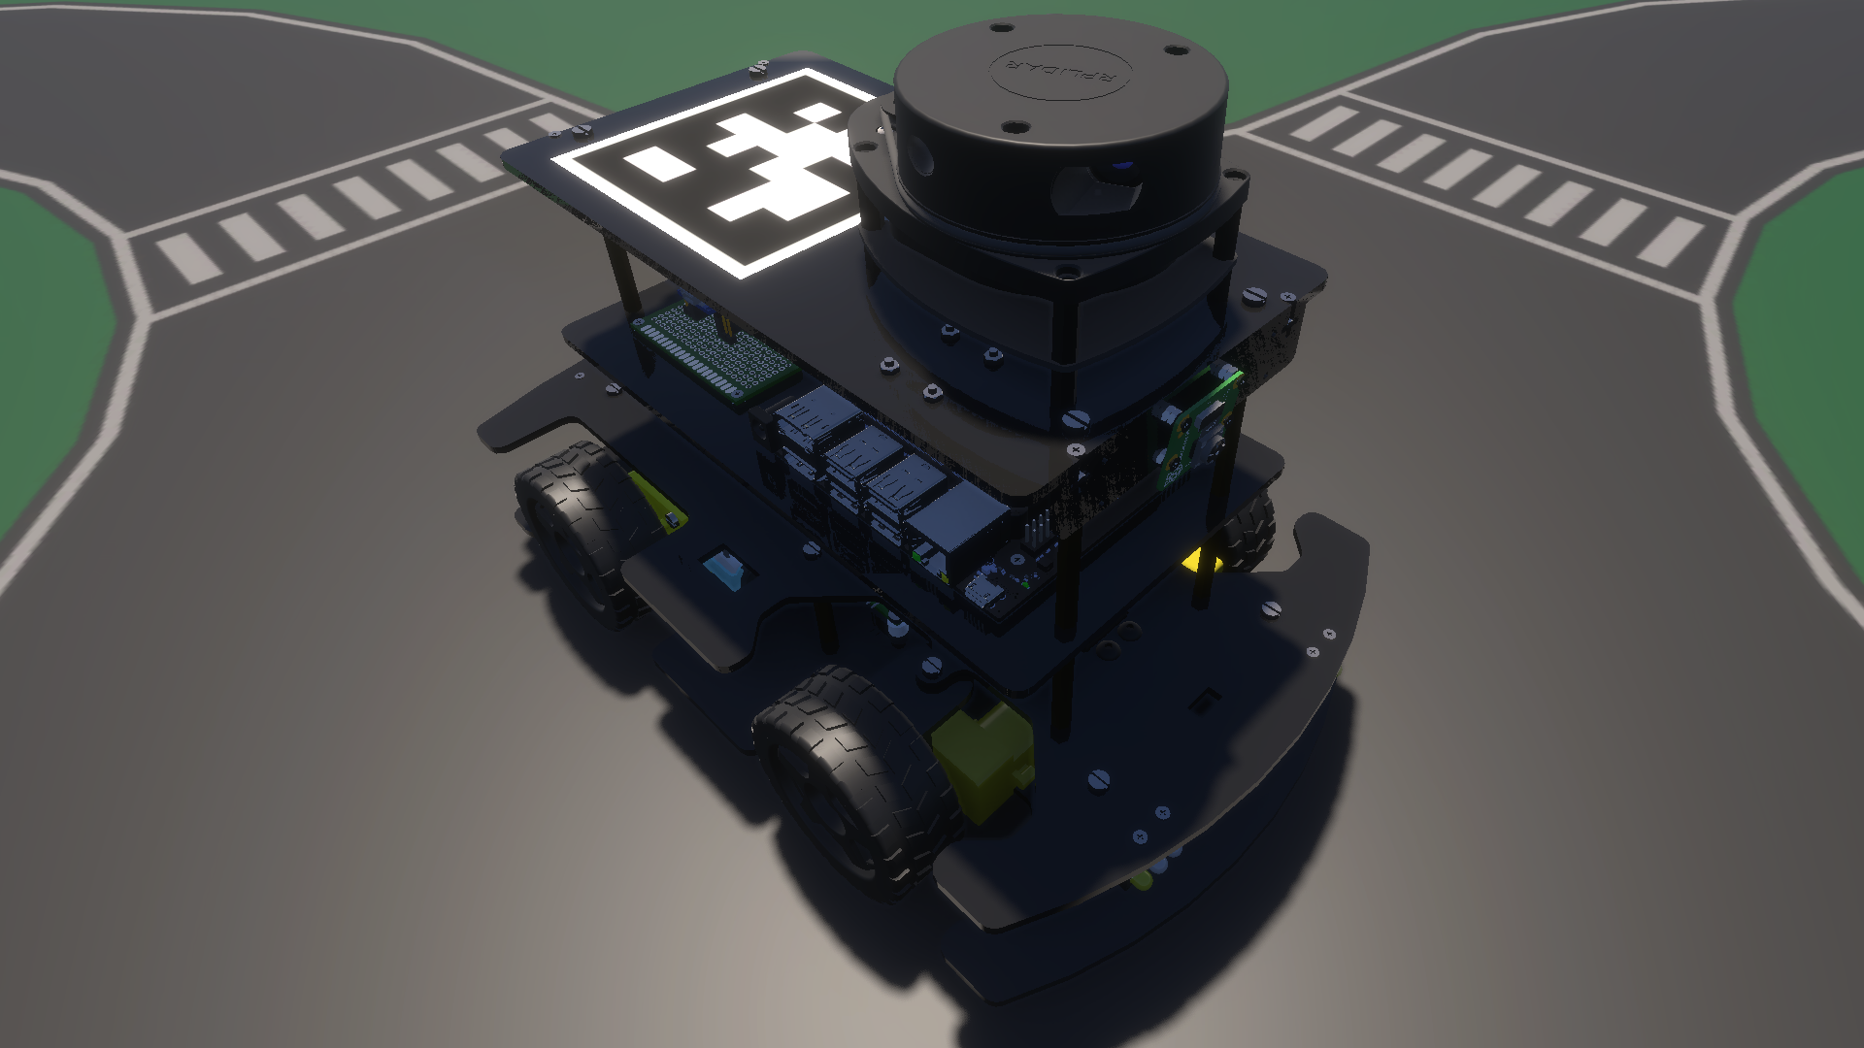
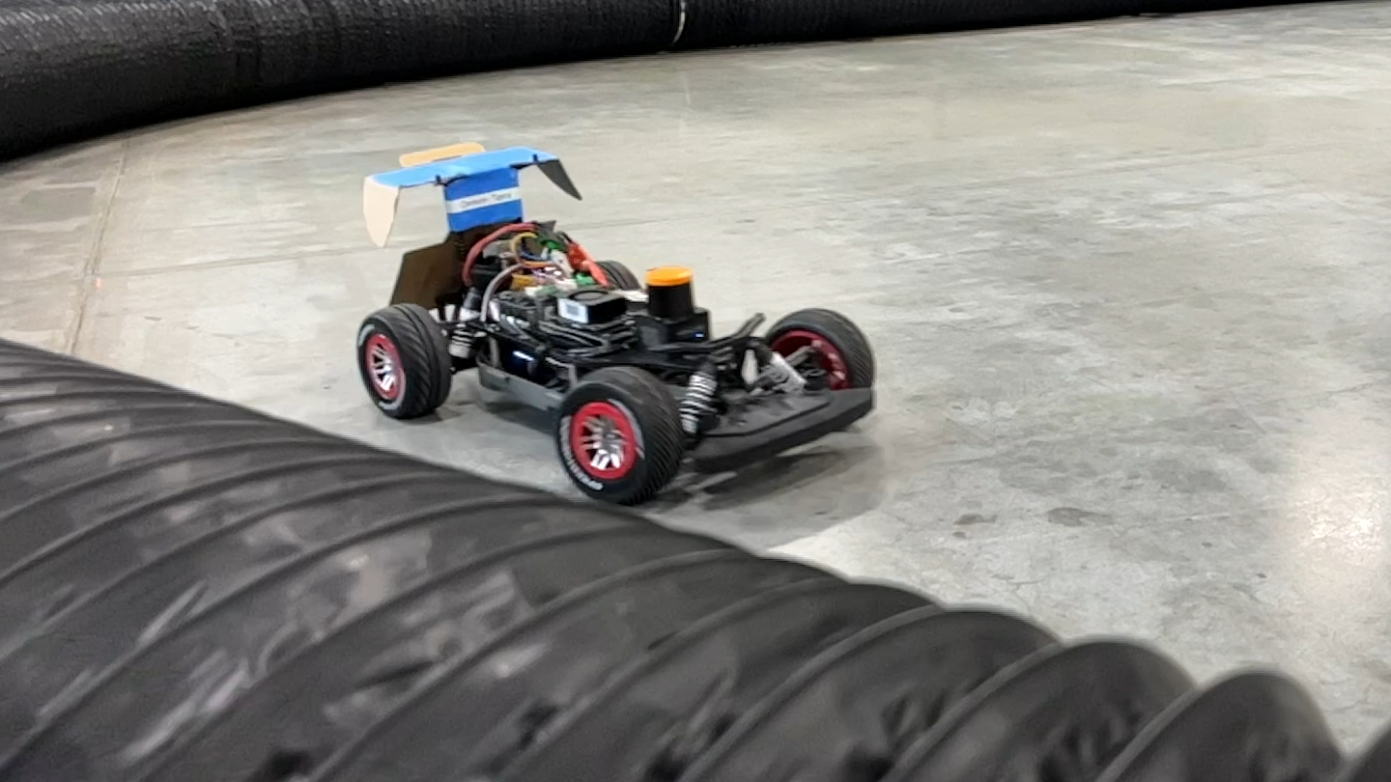
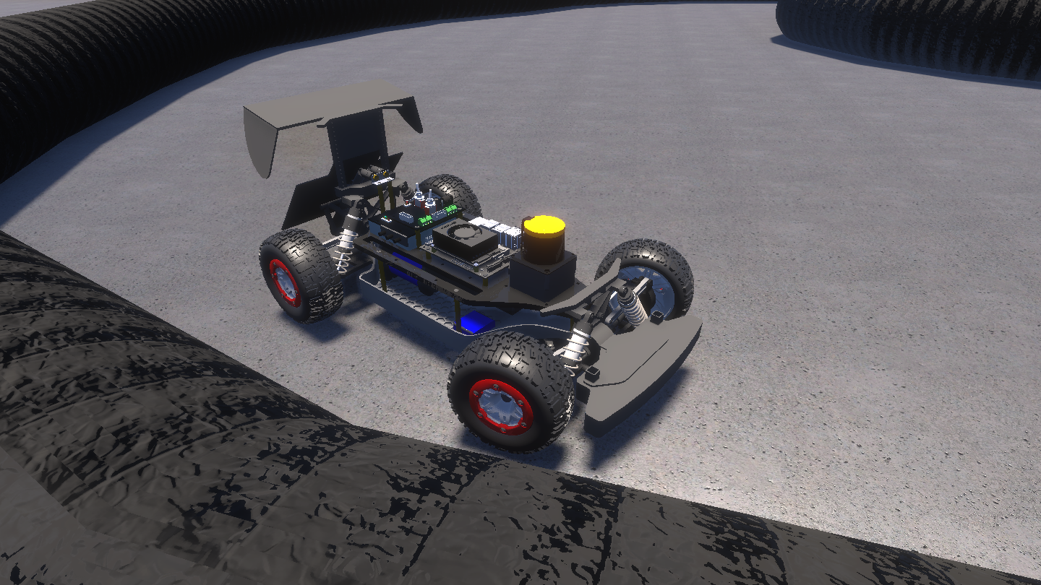
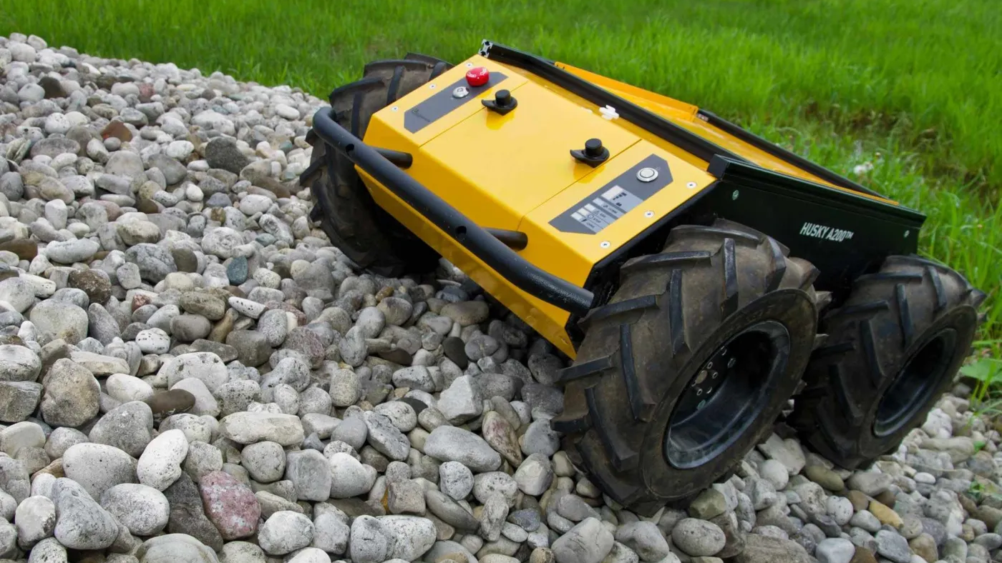
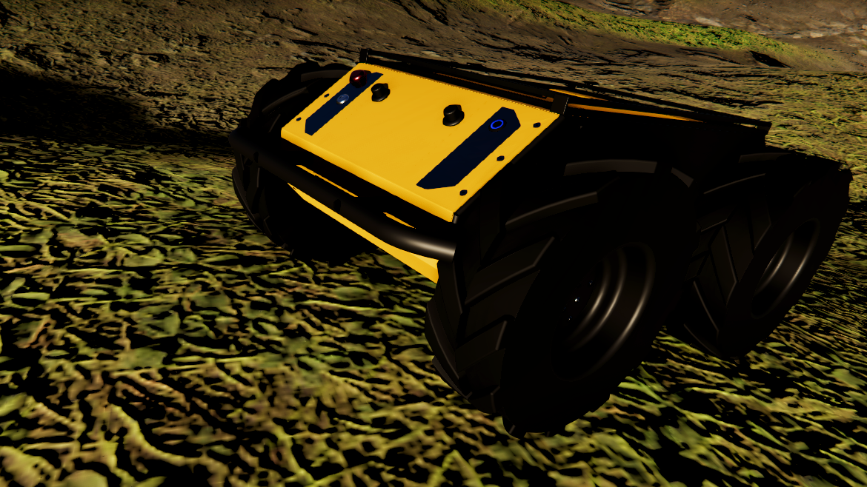
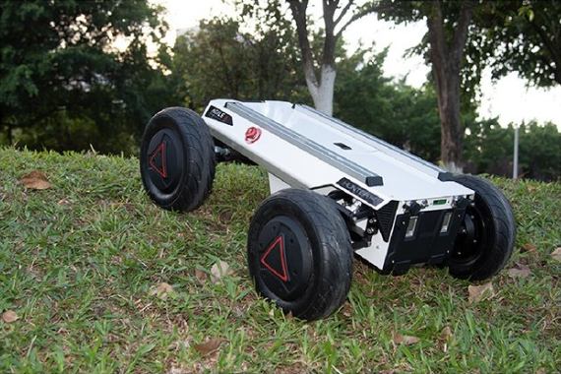
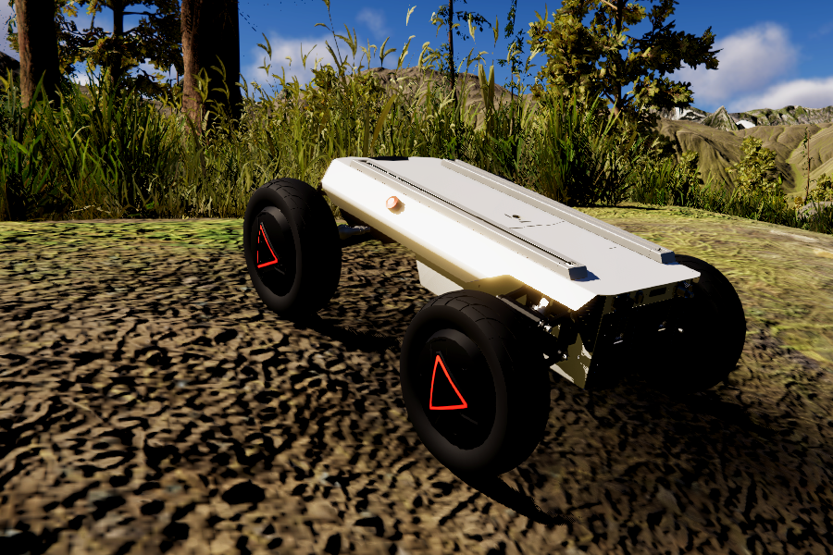
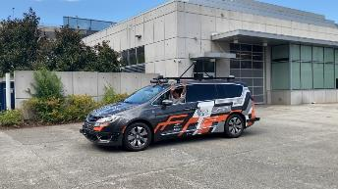
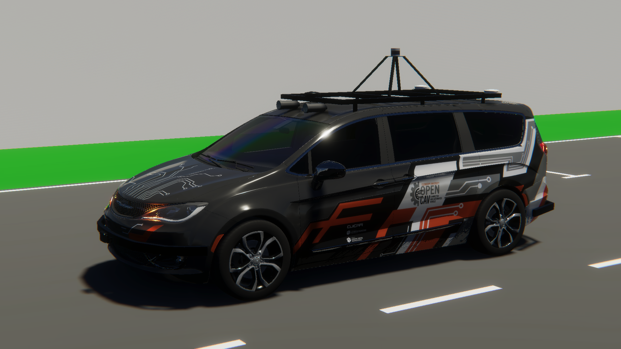
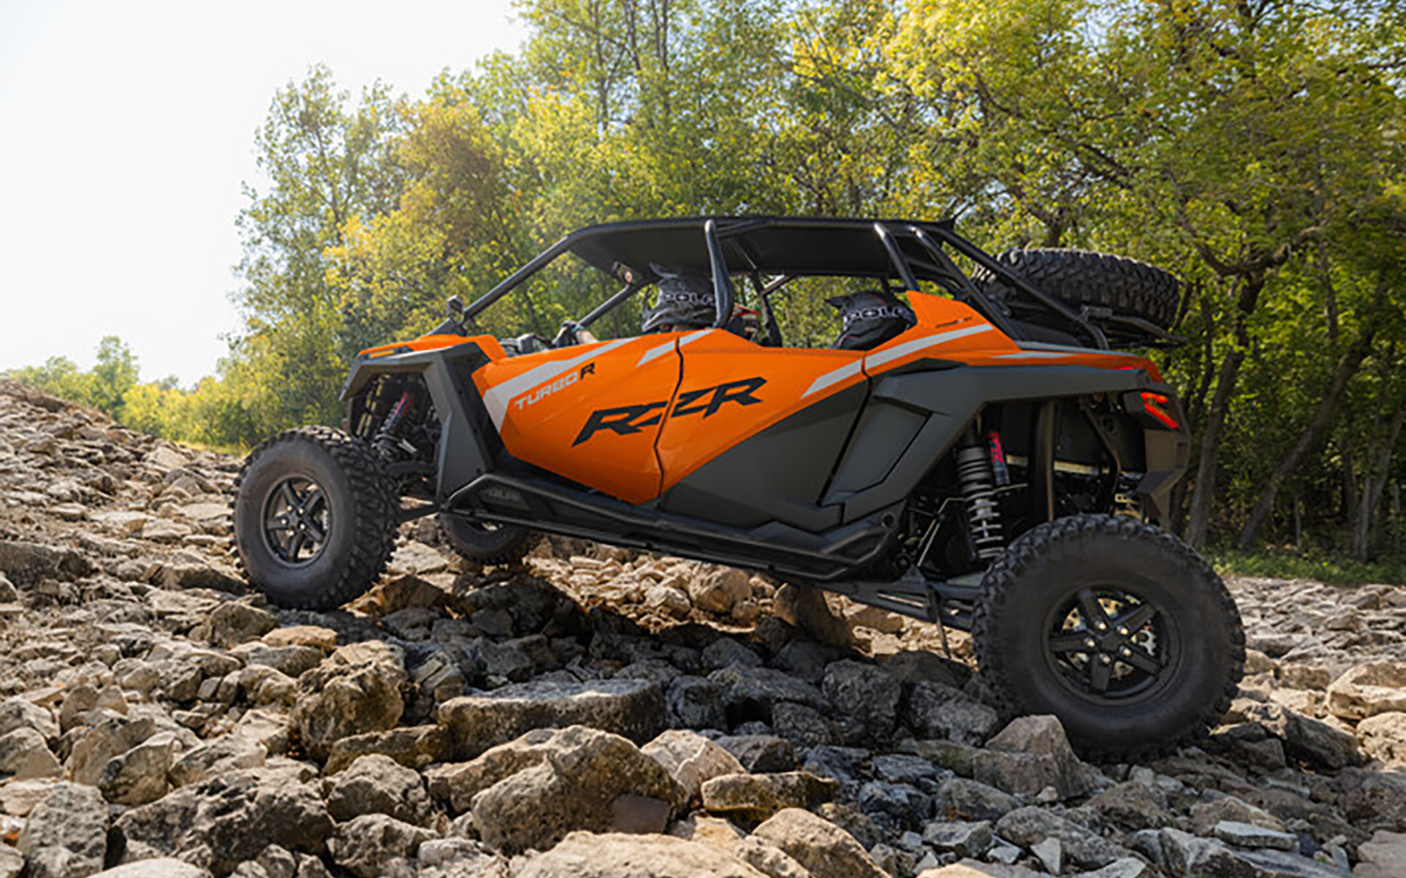
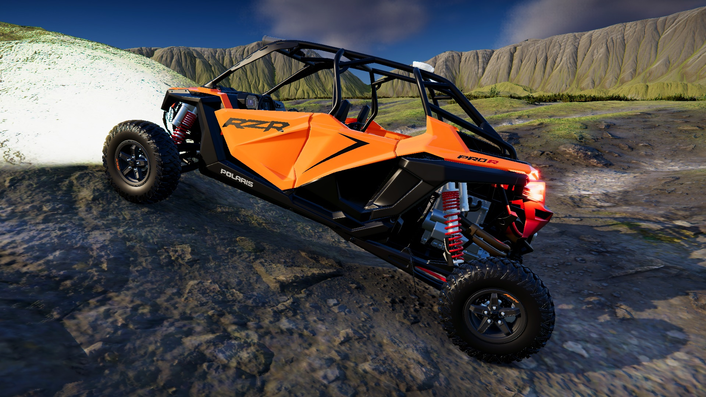
Digital Twin Models in AutoDRIVE Ecosystem
SMALL-SCALE
Nigel (Native Vehicle)
F1TENTH (1/10th Scale Racecar)
MID-SCALE
Husky (On/Off-Road Skid-Steer Robot)
Hunter SE (On/Off-Road Ackermann Steered Vehicle)
FULL-SCALE
OpenCAV (On-Road Commercial Vehicle)
RZR (Recreational Off-Highway Vehicle)
Source: AutoDRIVE Ecosystem

Slide 5
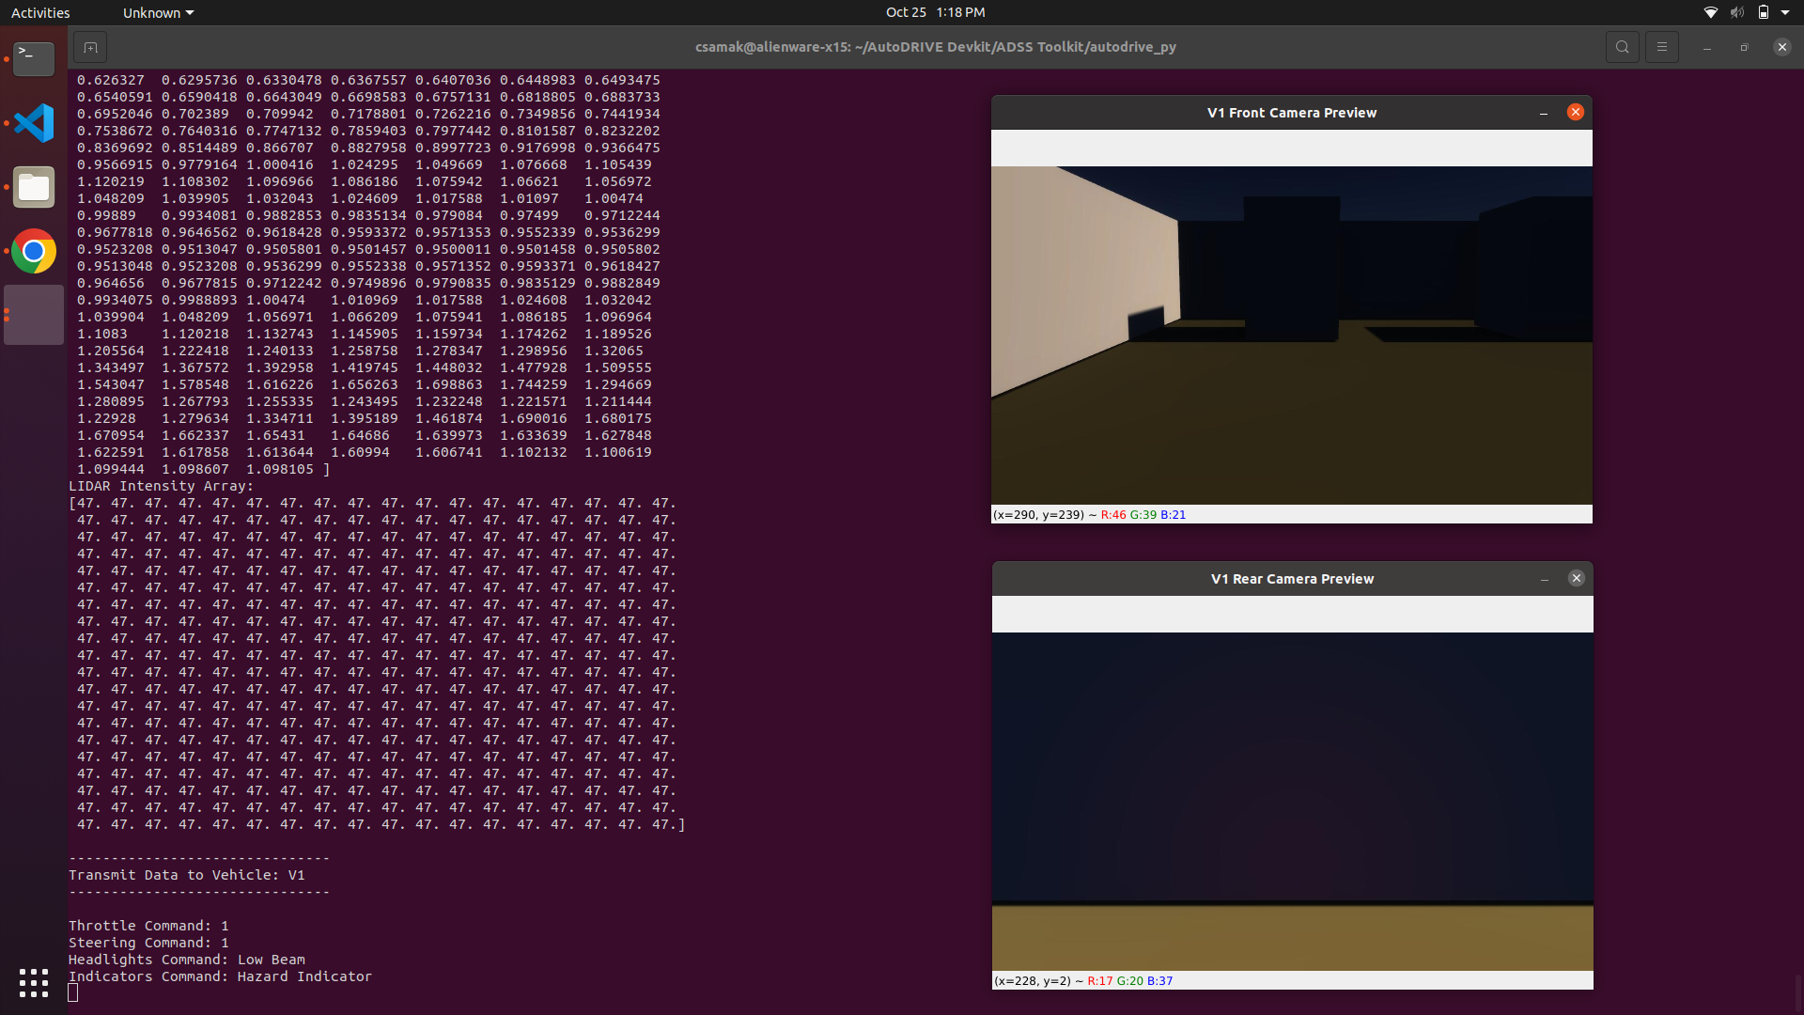
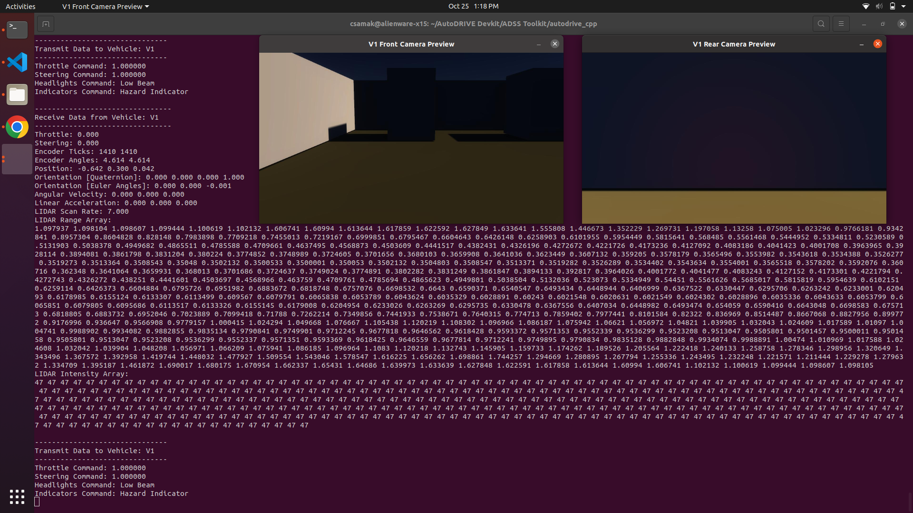
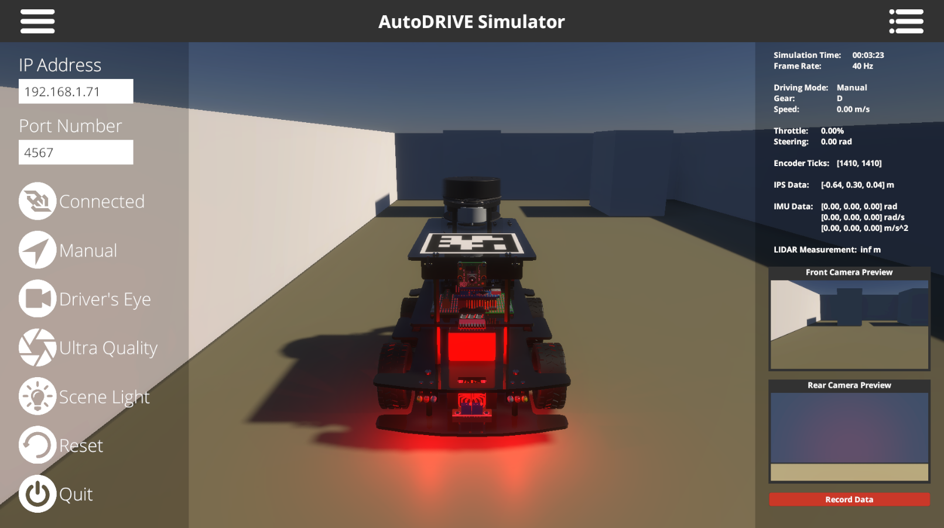


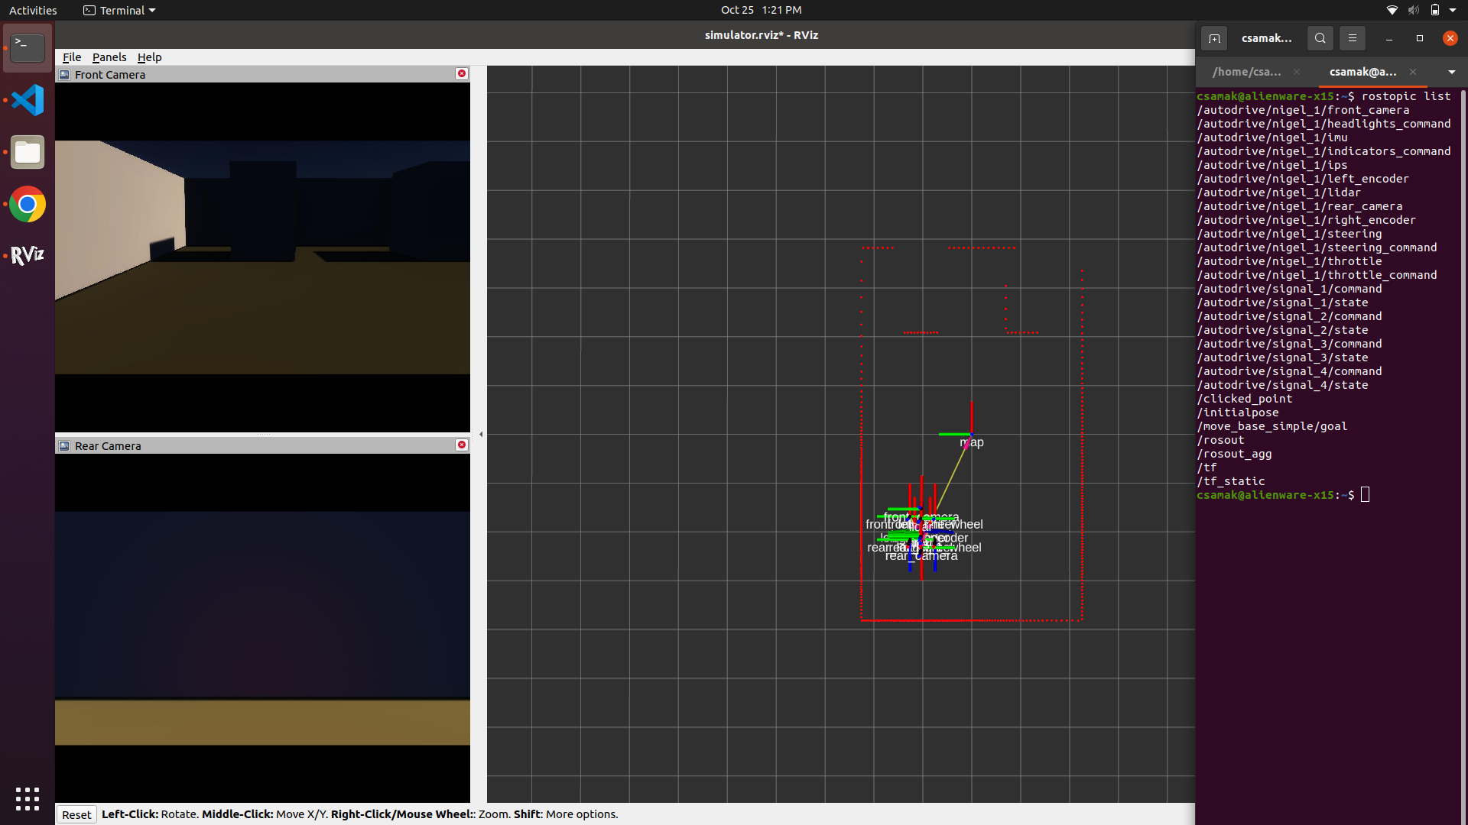
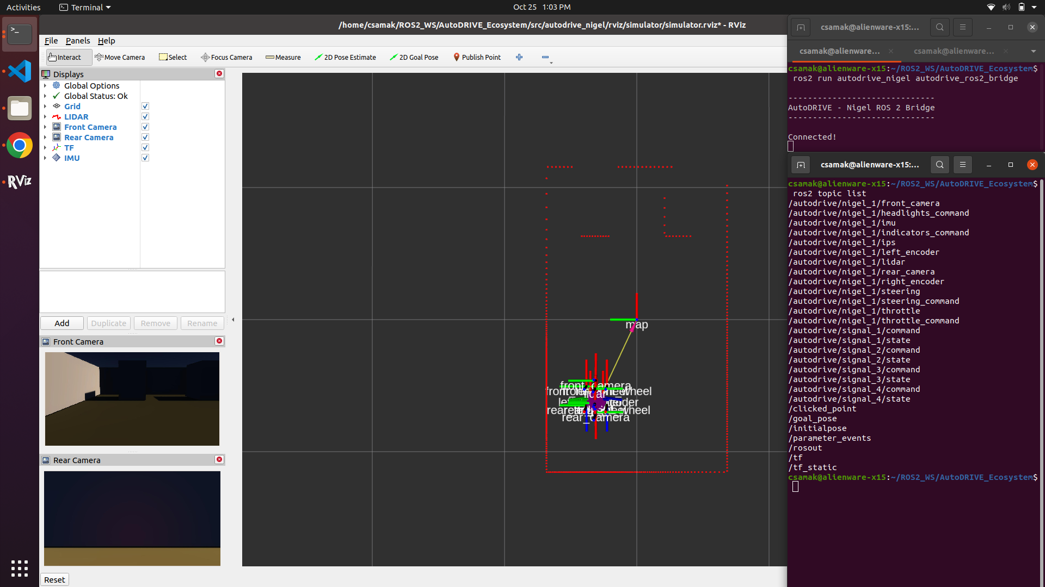


APIs to connect with AutoDRIVE Ecosystem
Python
C++
AutoDRIVE
Autoware Integration Complete
[Demo in Progress]
ROS
ROS 2

Slide 6
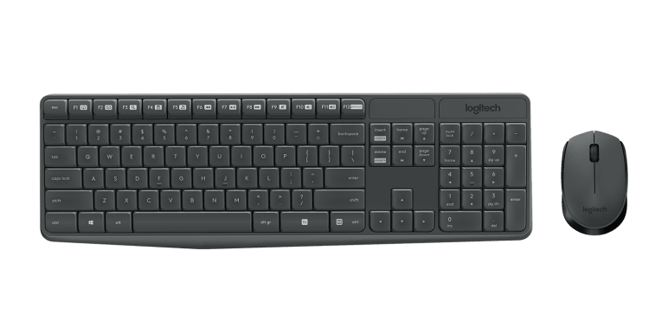
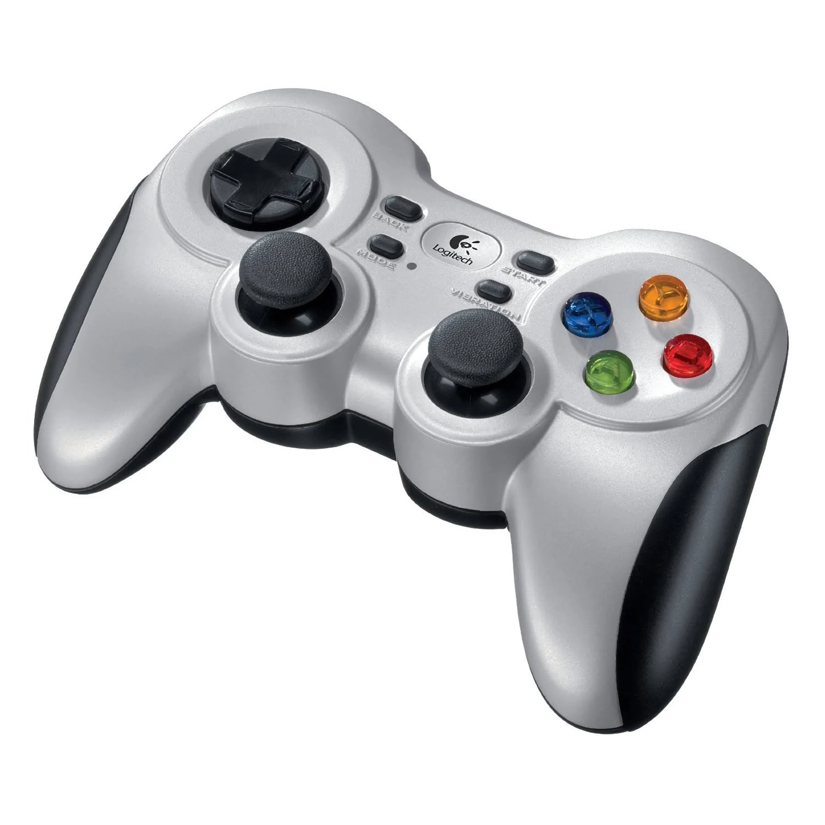
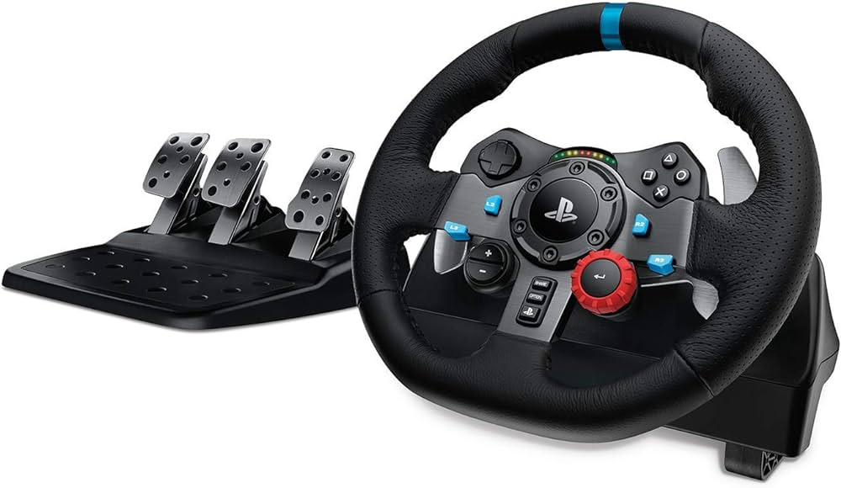

HMIs to connect with AutoDRIVE Ecosystem
AutoDRIVE
Keyboard+Mouse
Gamepad
Driving Rig
Direct HMI vs. API-Mediated HMI

Slide 7
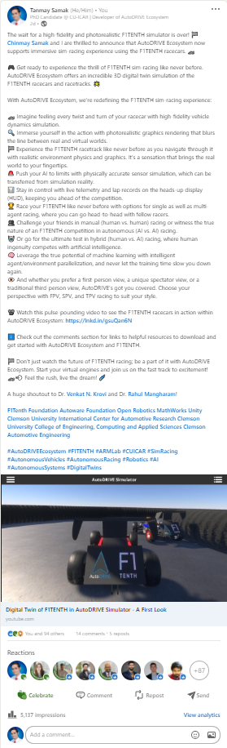
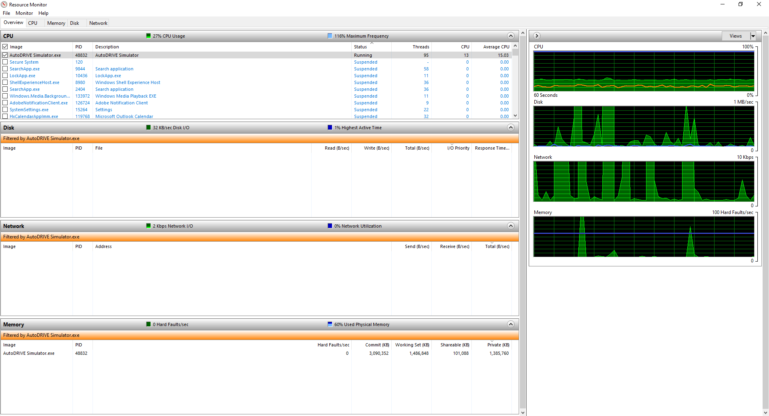
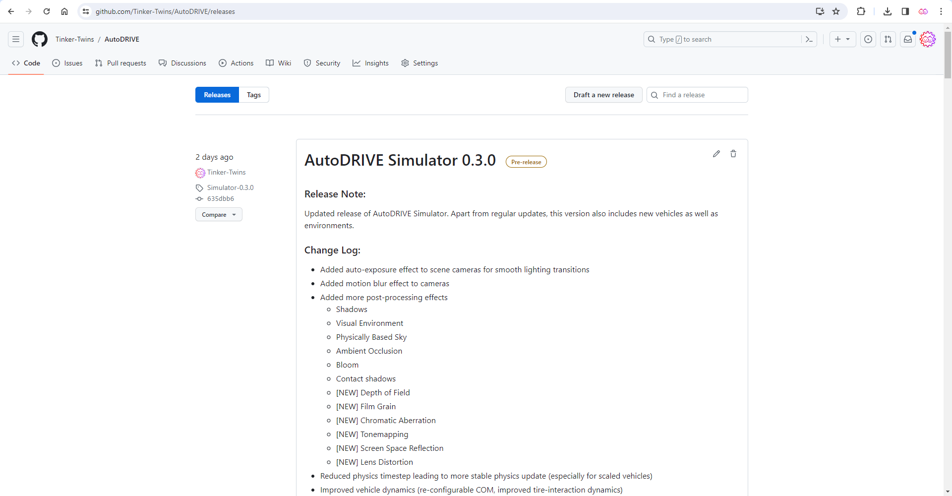
AutoDRIVE Ecosystem Update Summary
Computing: Multi-threading & GPU instancing
Profiling: Alienware X15 R2
New Robots: Husky, Hunter SE
Sensors:
Modularize 2D and 3D LIDARs
API for 3D LIDAR [Tested with Husky]
Release:
AutoDRIVE Simulator 0.3.0
AutoDRIVE Devkit 0.3.0
LinkedIn Post
Nigel assembly guide and BOM

Slide 8
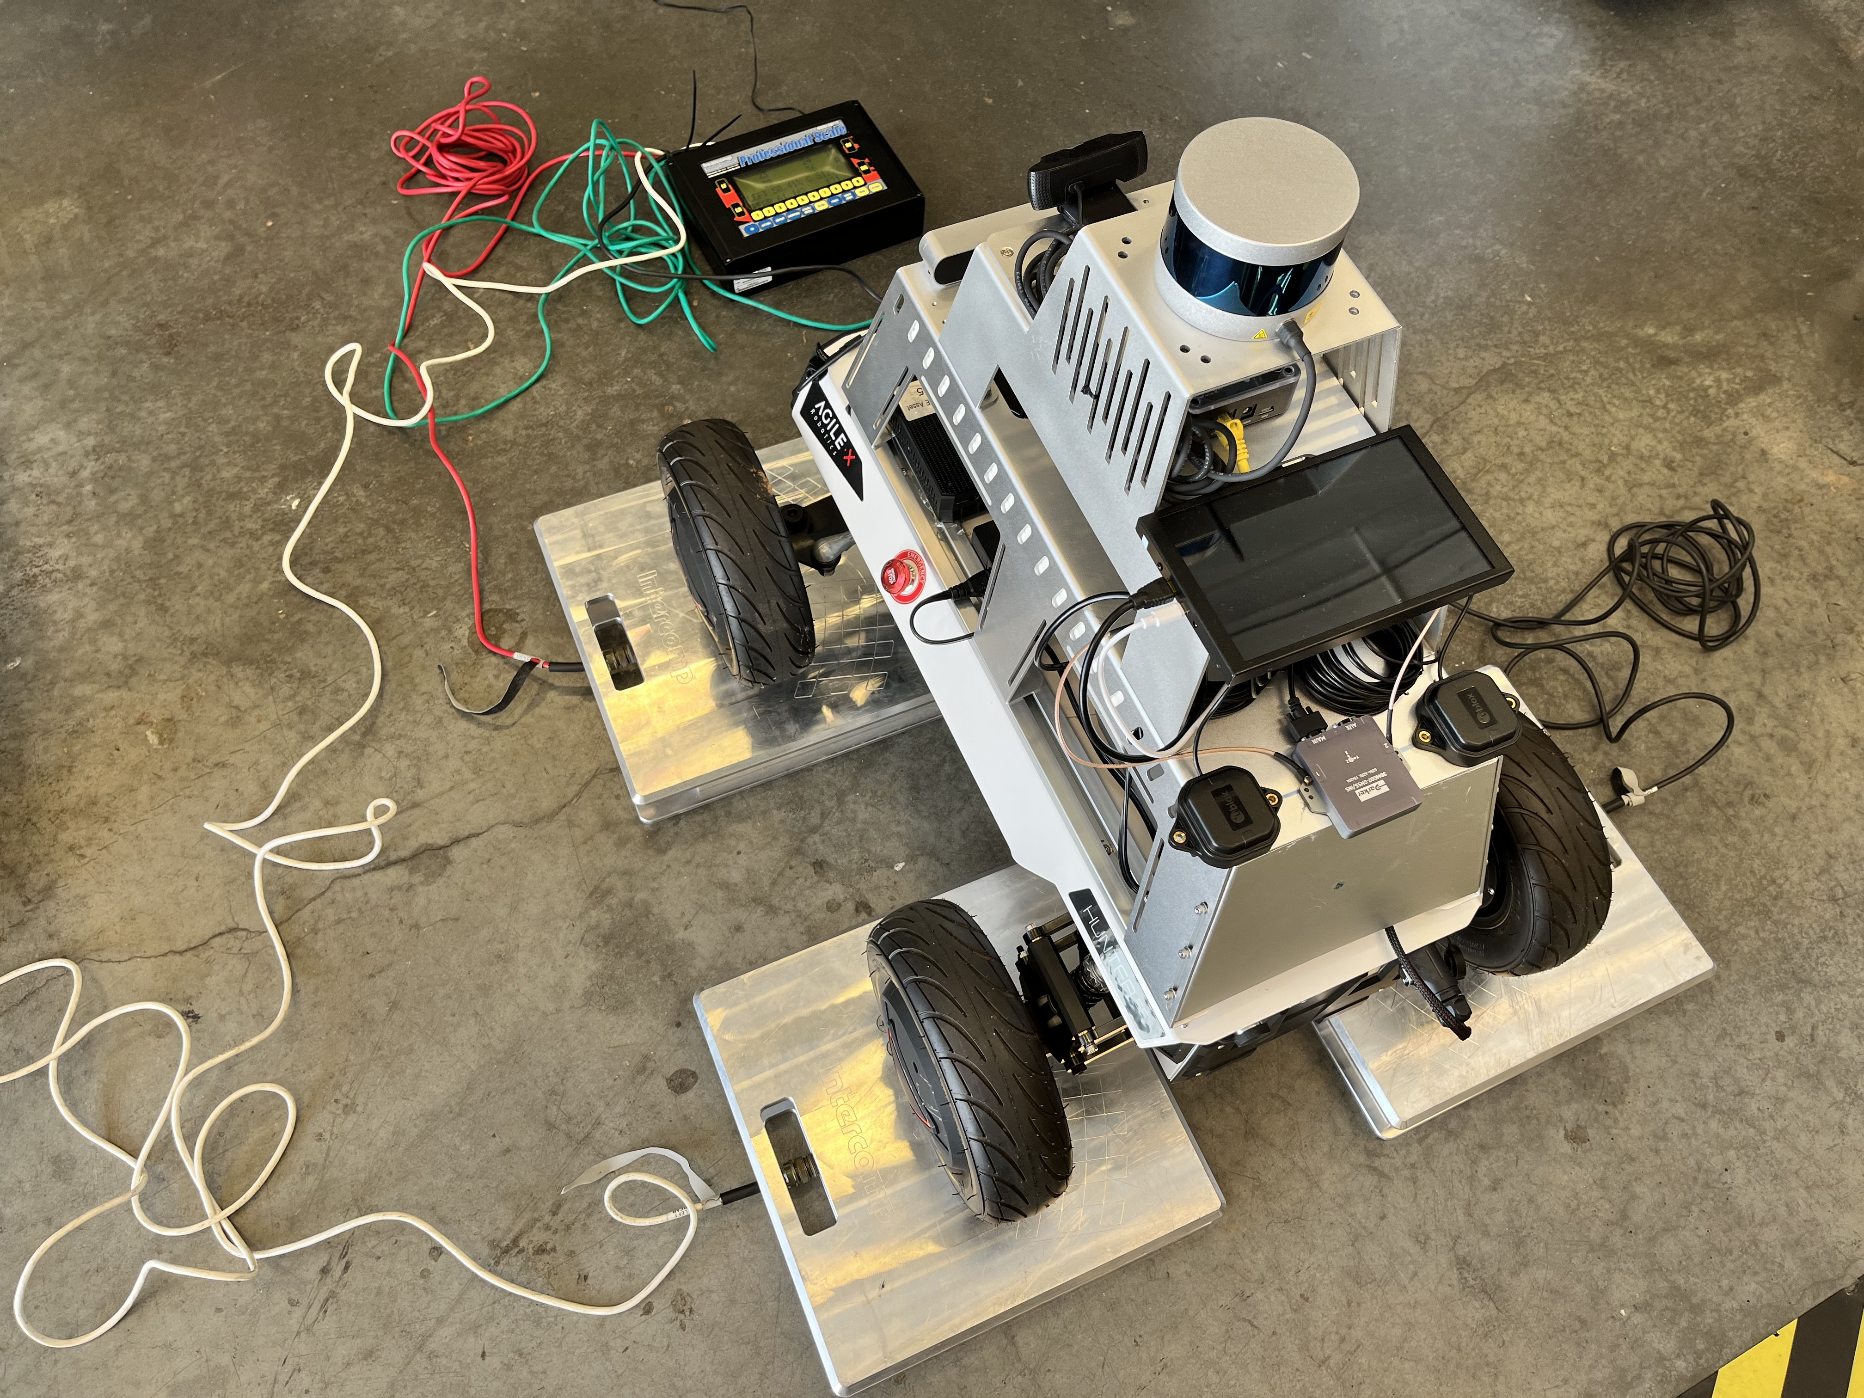
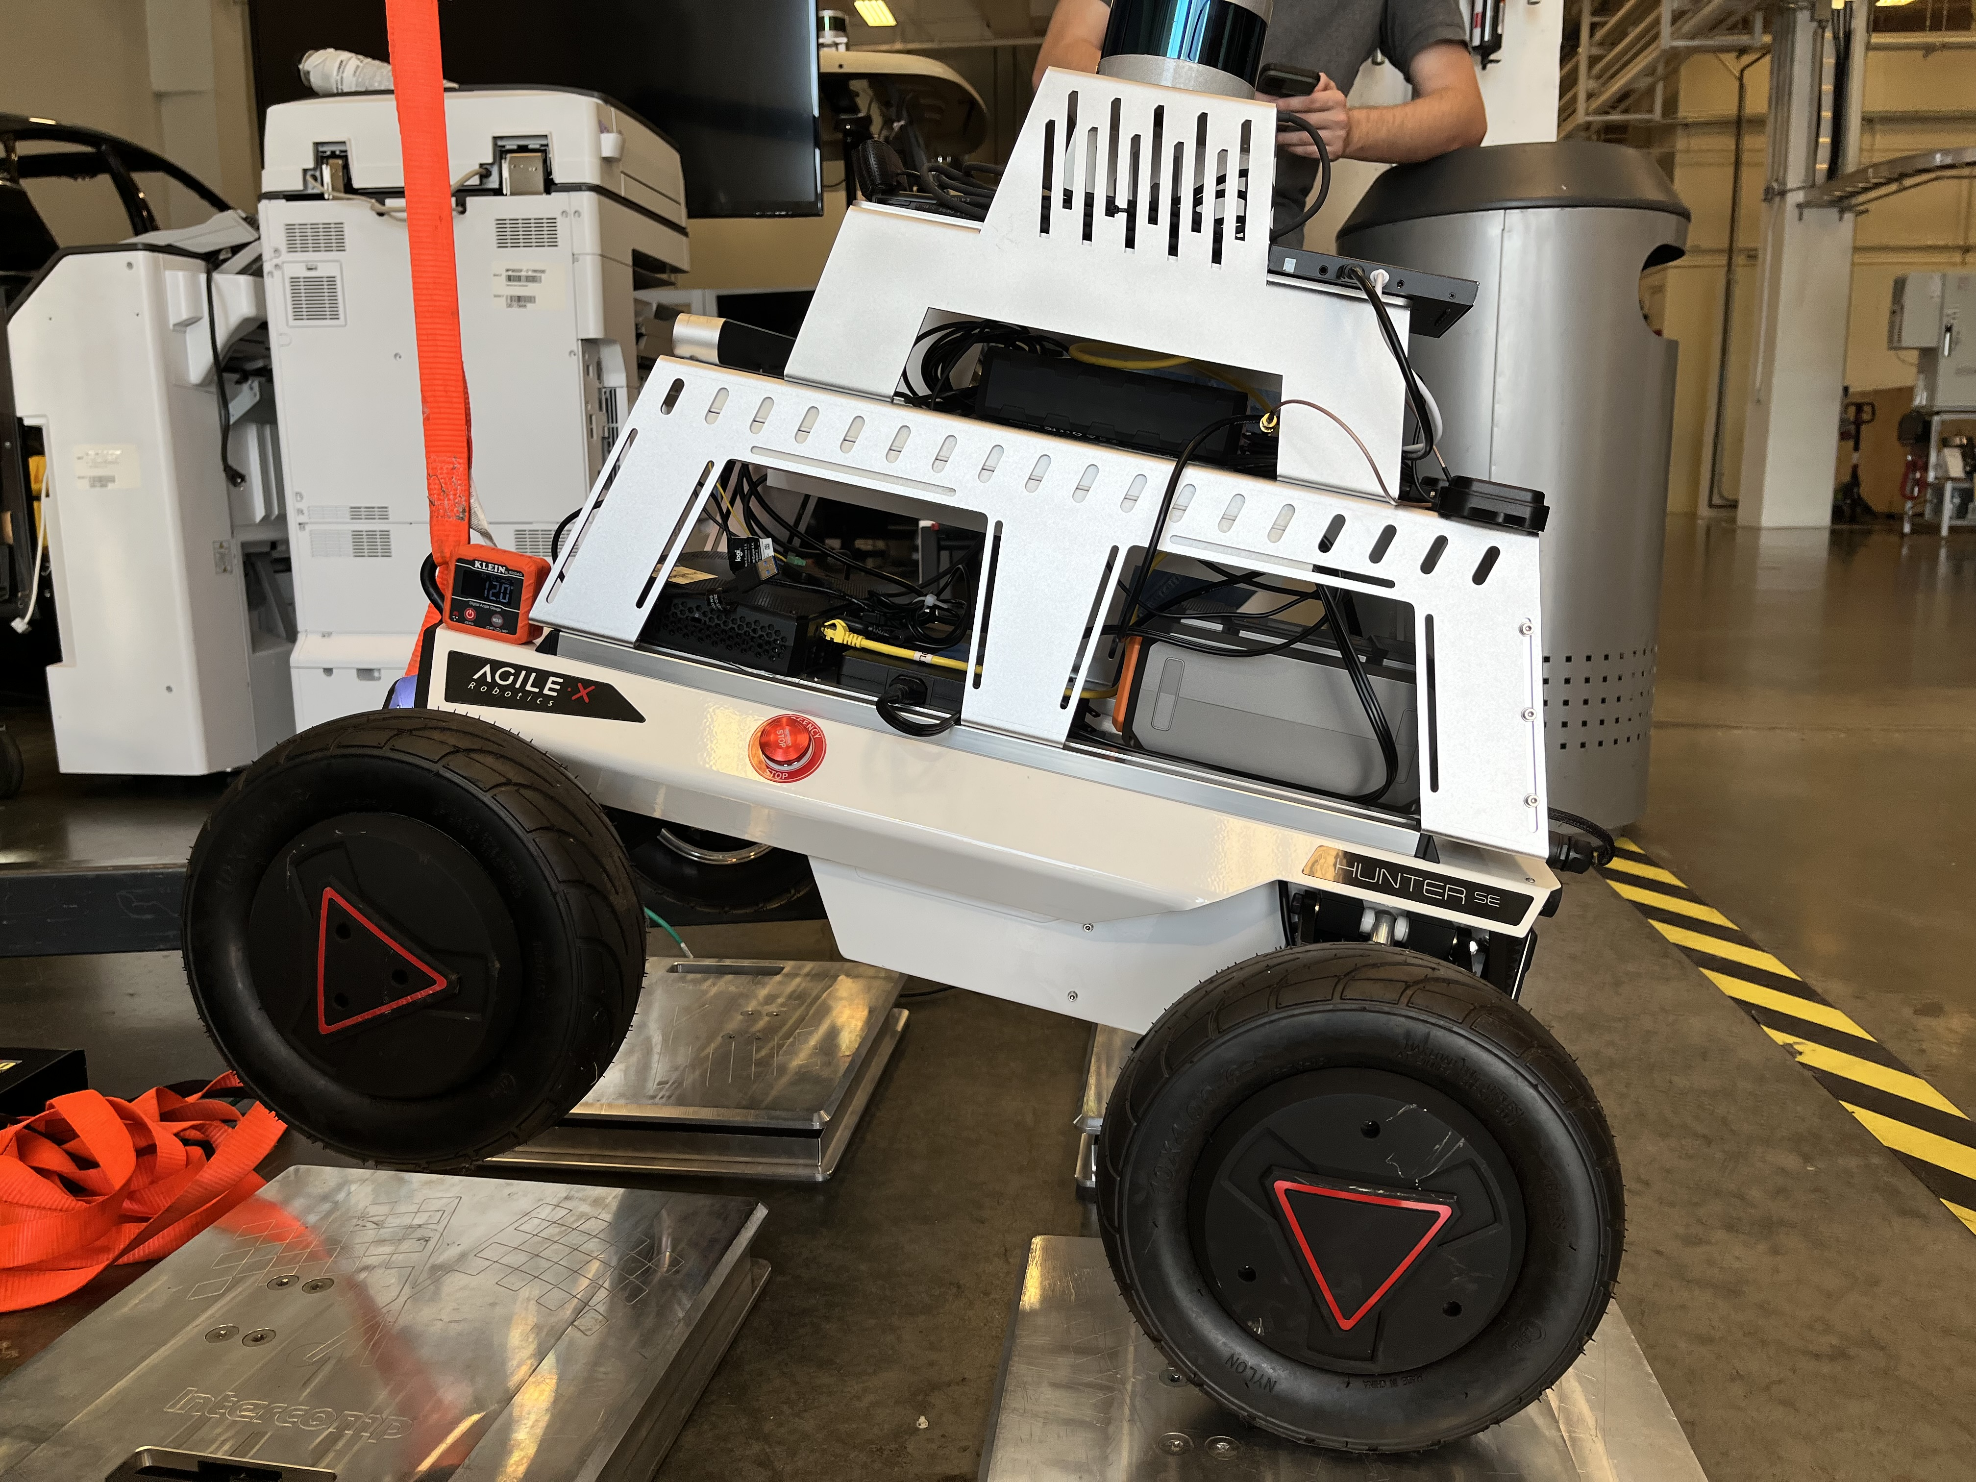
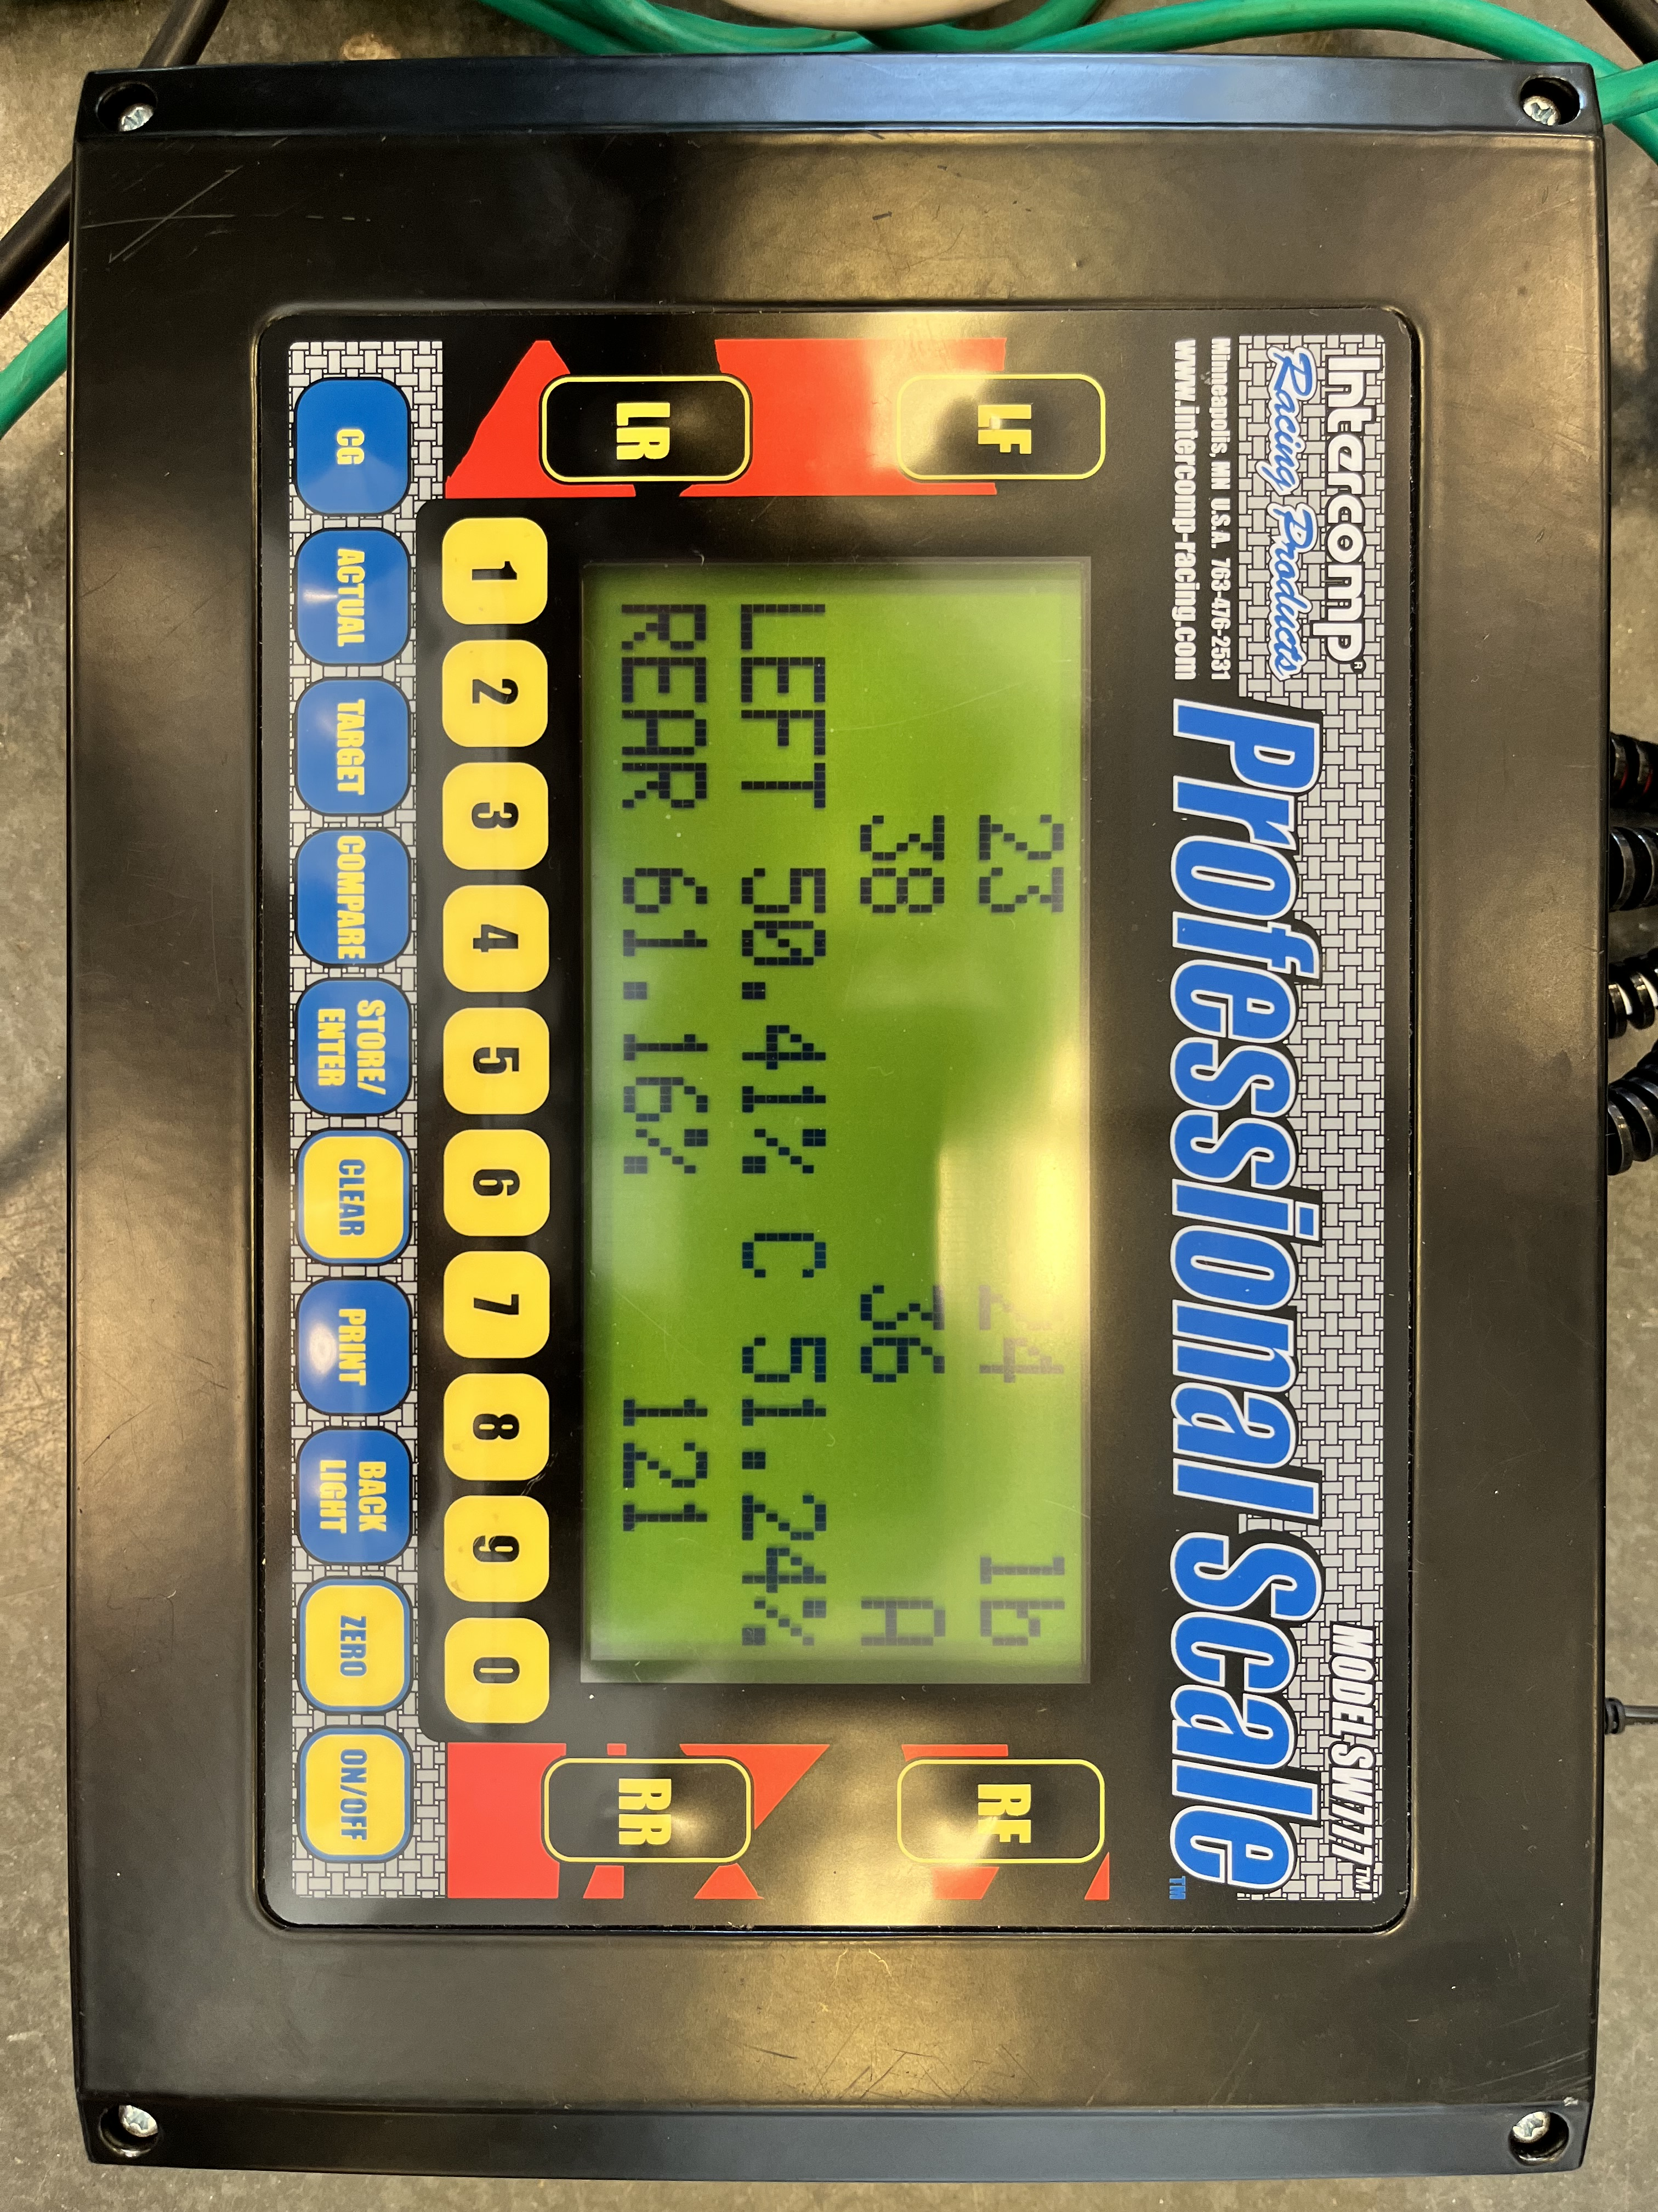
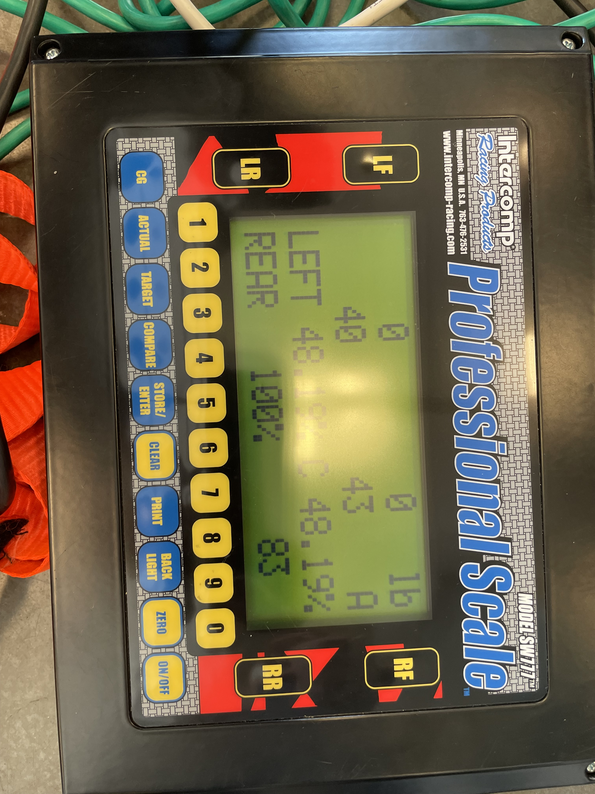
Mid-Scale Robot Update Summary
Hunter SE System ID
Geometric Measurements
Static measurements
Mass identification
CoM identification
Actuator limits ID [TODO]
Husky System ID
Geometric Measurements
Static measurements
TODO
Actuator limits ID [in progress]

Slide 9
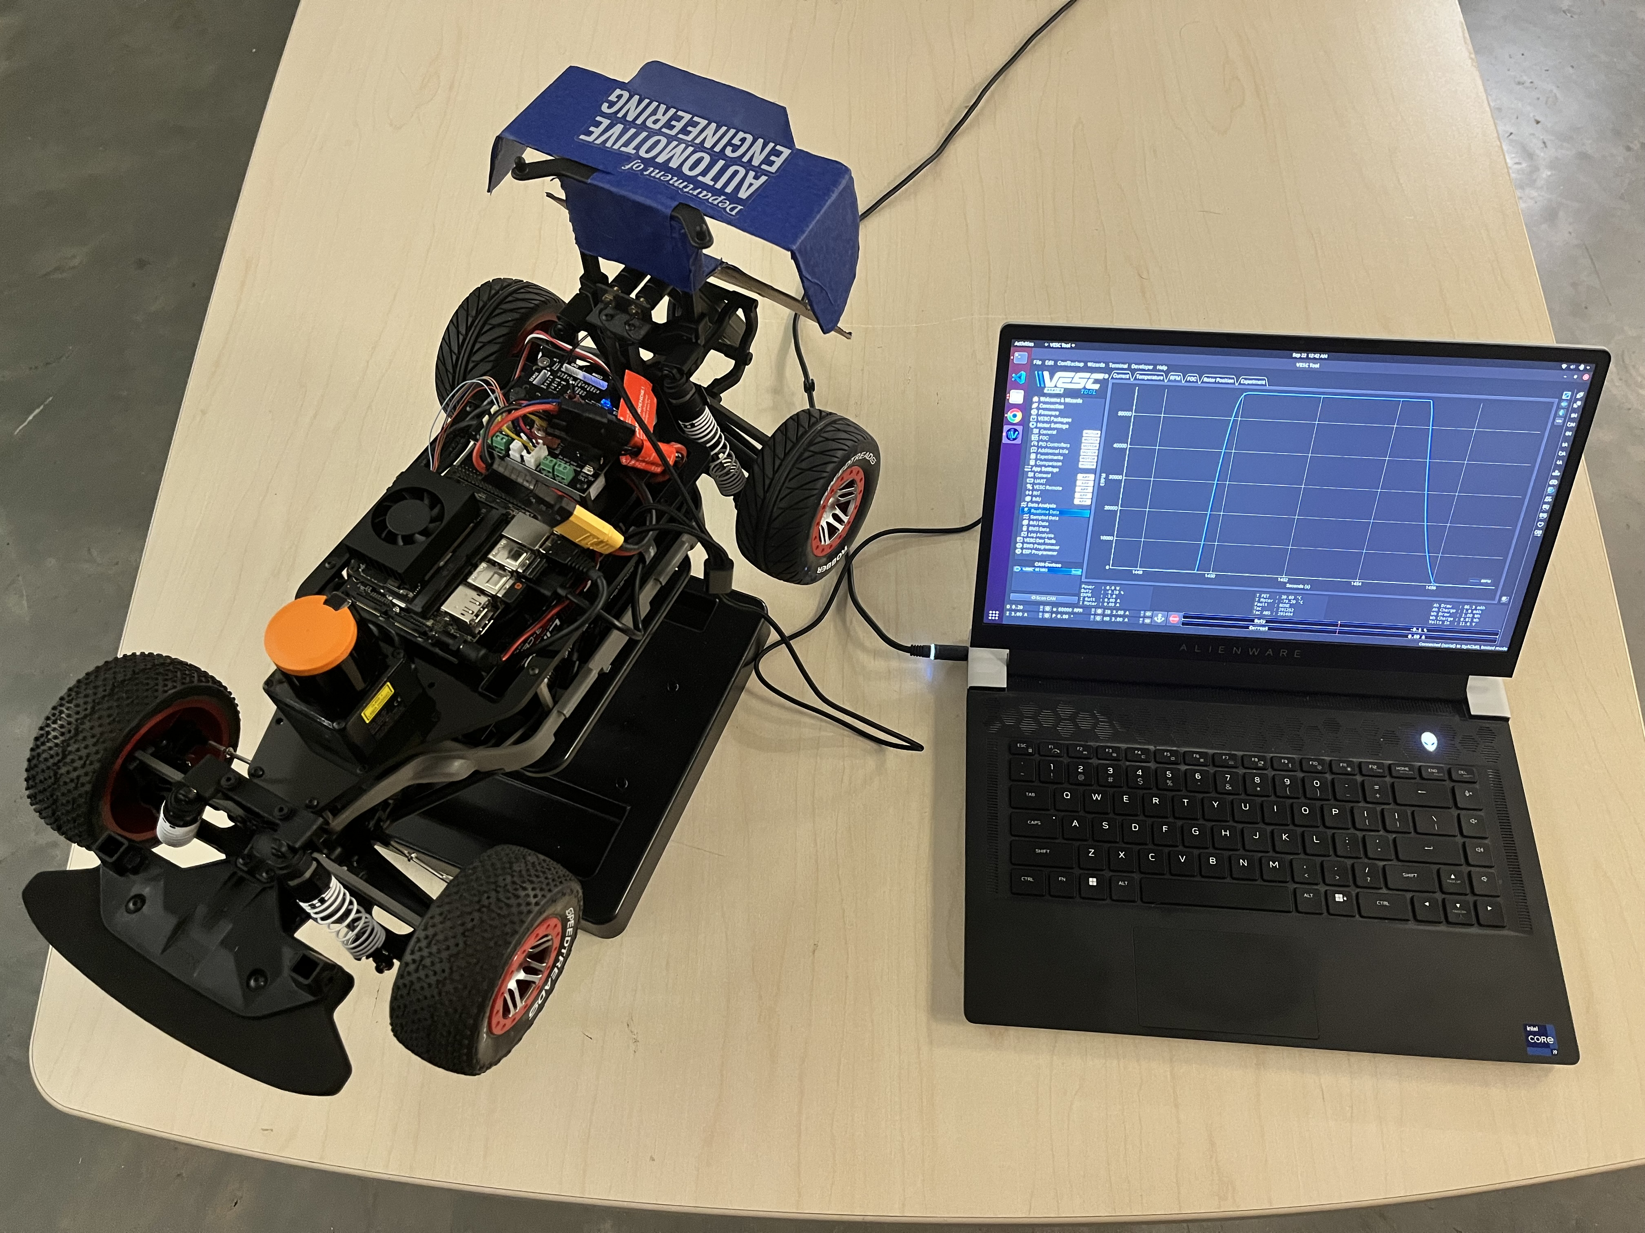
F1TENTH Update Summary
Reflash microSD Card with L4T Ubuntu 20.04
JetPack 5.1.1
Flashing instructions [1] [2]
Configure hardware/software
Install VNC for display forwarding
Install HDMI emulator
Install and configure Logitech F710 module
Hokuyo 10LX network configuration
VESC tuning and configuration
VESC calibration for odometry (steer/drive)
Static udev rules for all peripherals

Slide 10
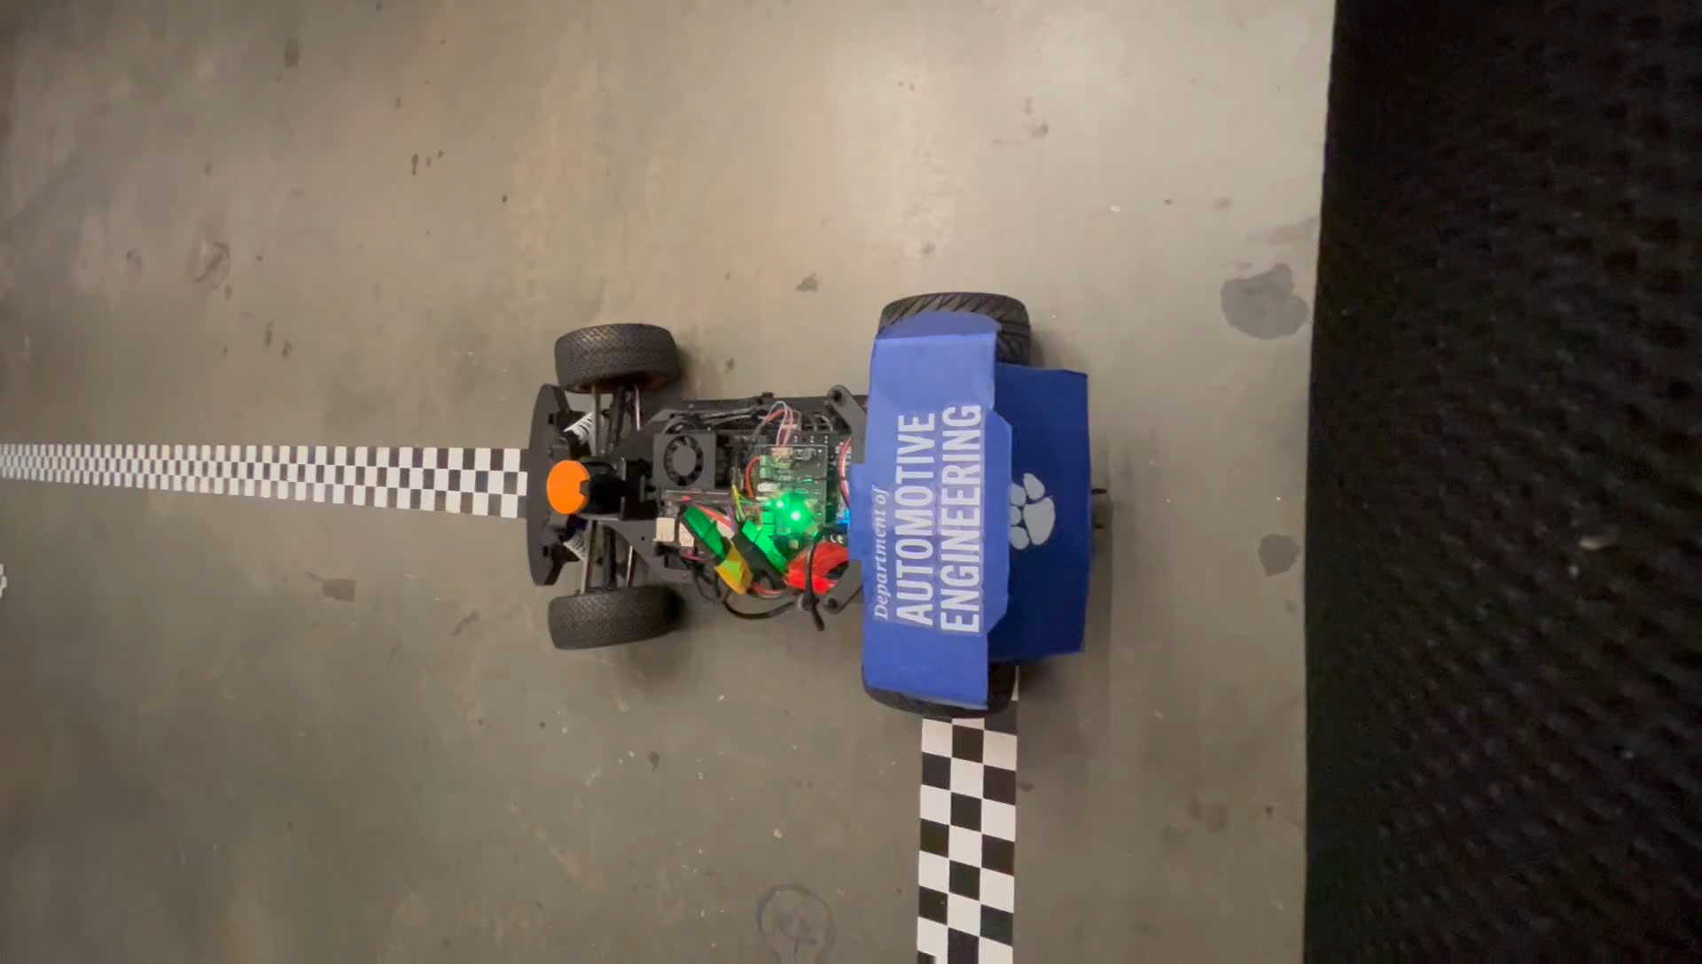
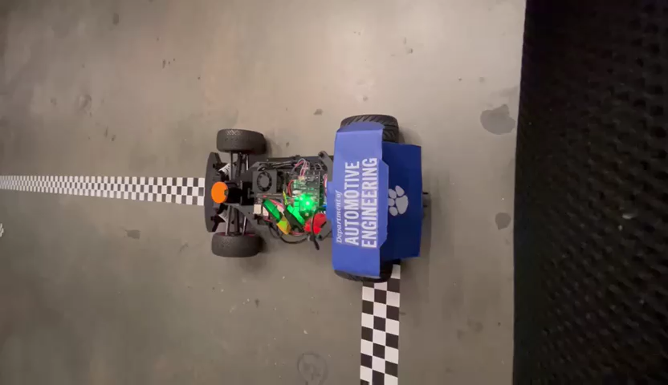
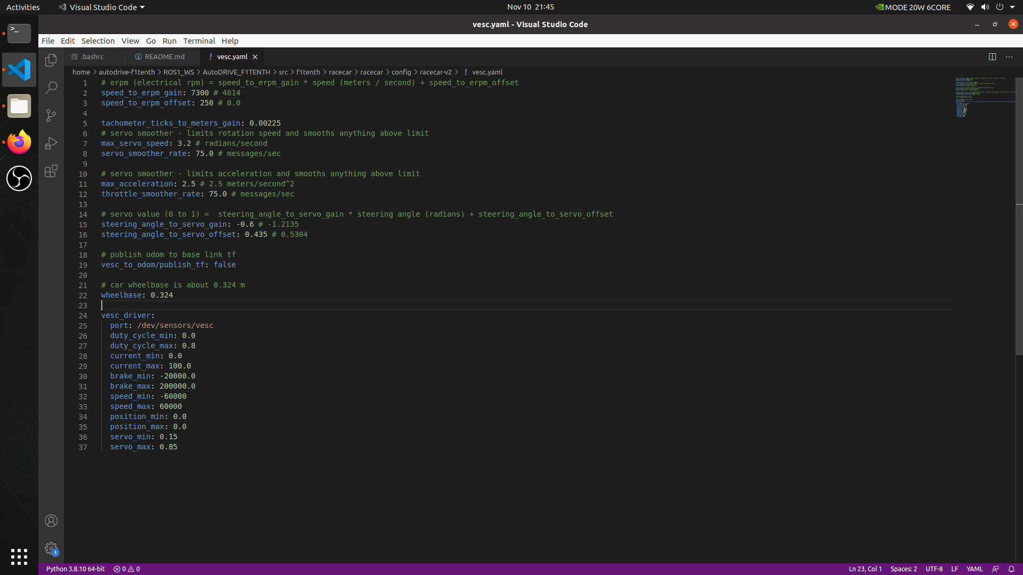
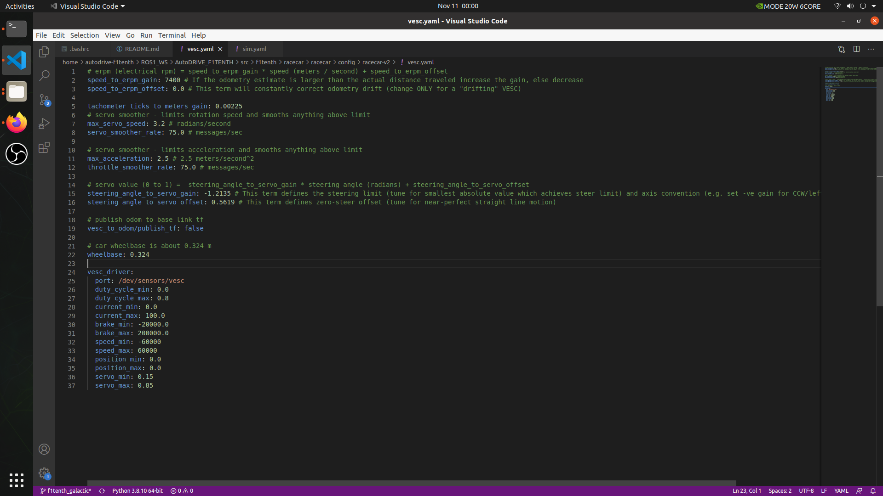
F1TENTH Update Summary
Reflash microSD Card with L4T Ubuntu 20.04
JetPack 5.1.1
Flashing instructions [1] [2]
Configure hardware/software
Install VNC for display forwarding
Install HDMI emulator
Install and configure Logitech F710 module
Hokuyo 10LX network configuration
VESC tuning and configuration
VESC calibration for odometry (steer/drive)
Static udev rules for all peripherals
Before
After

Slide 11
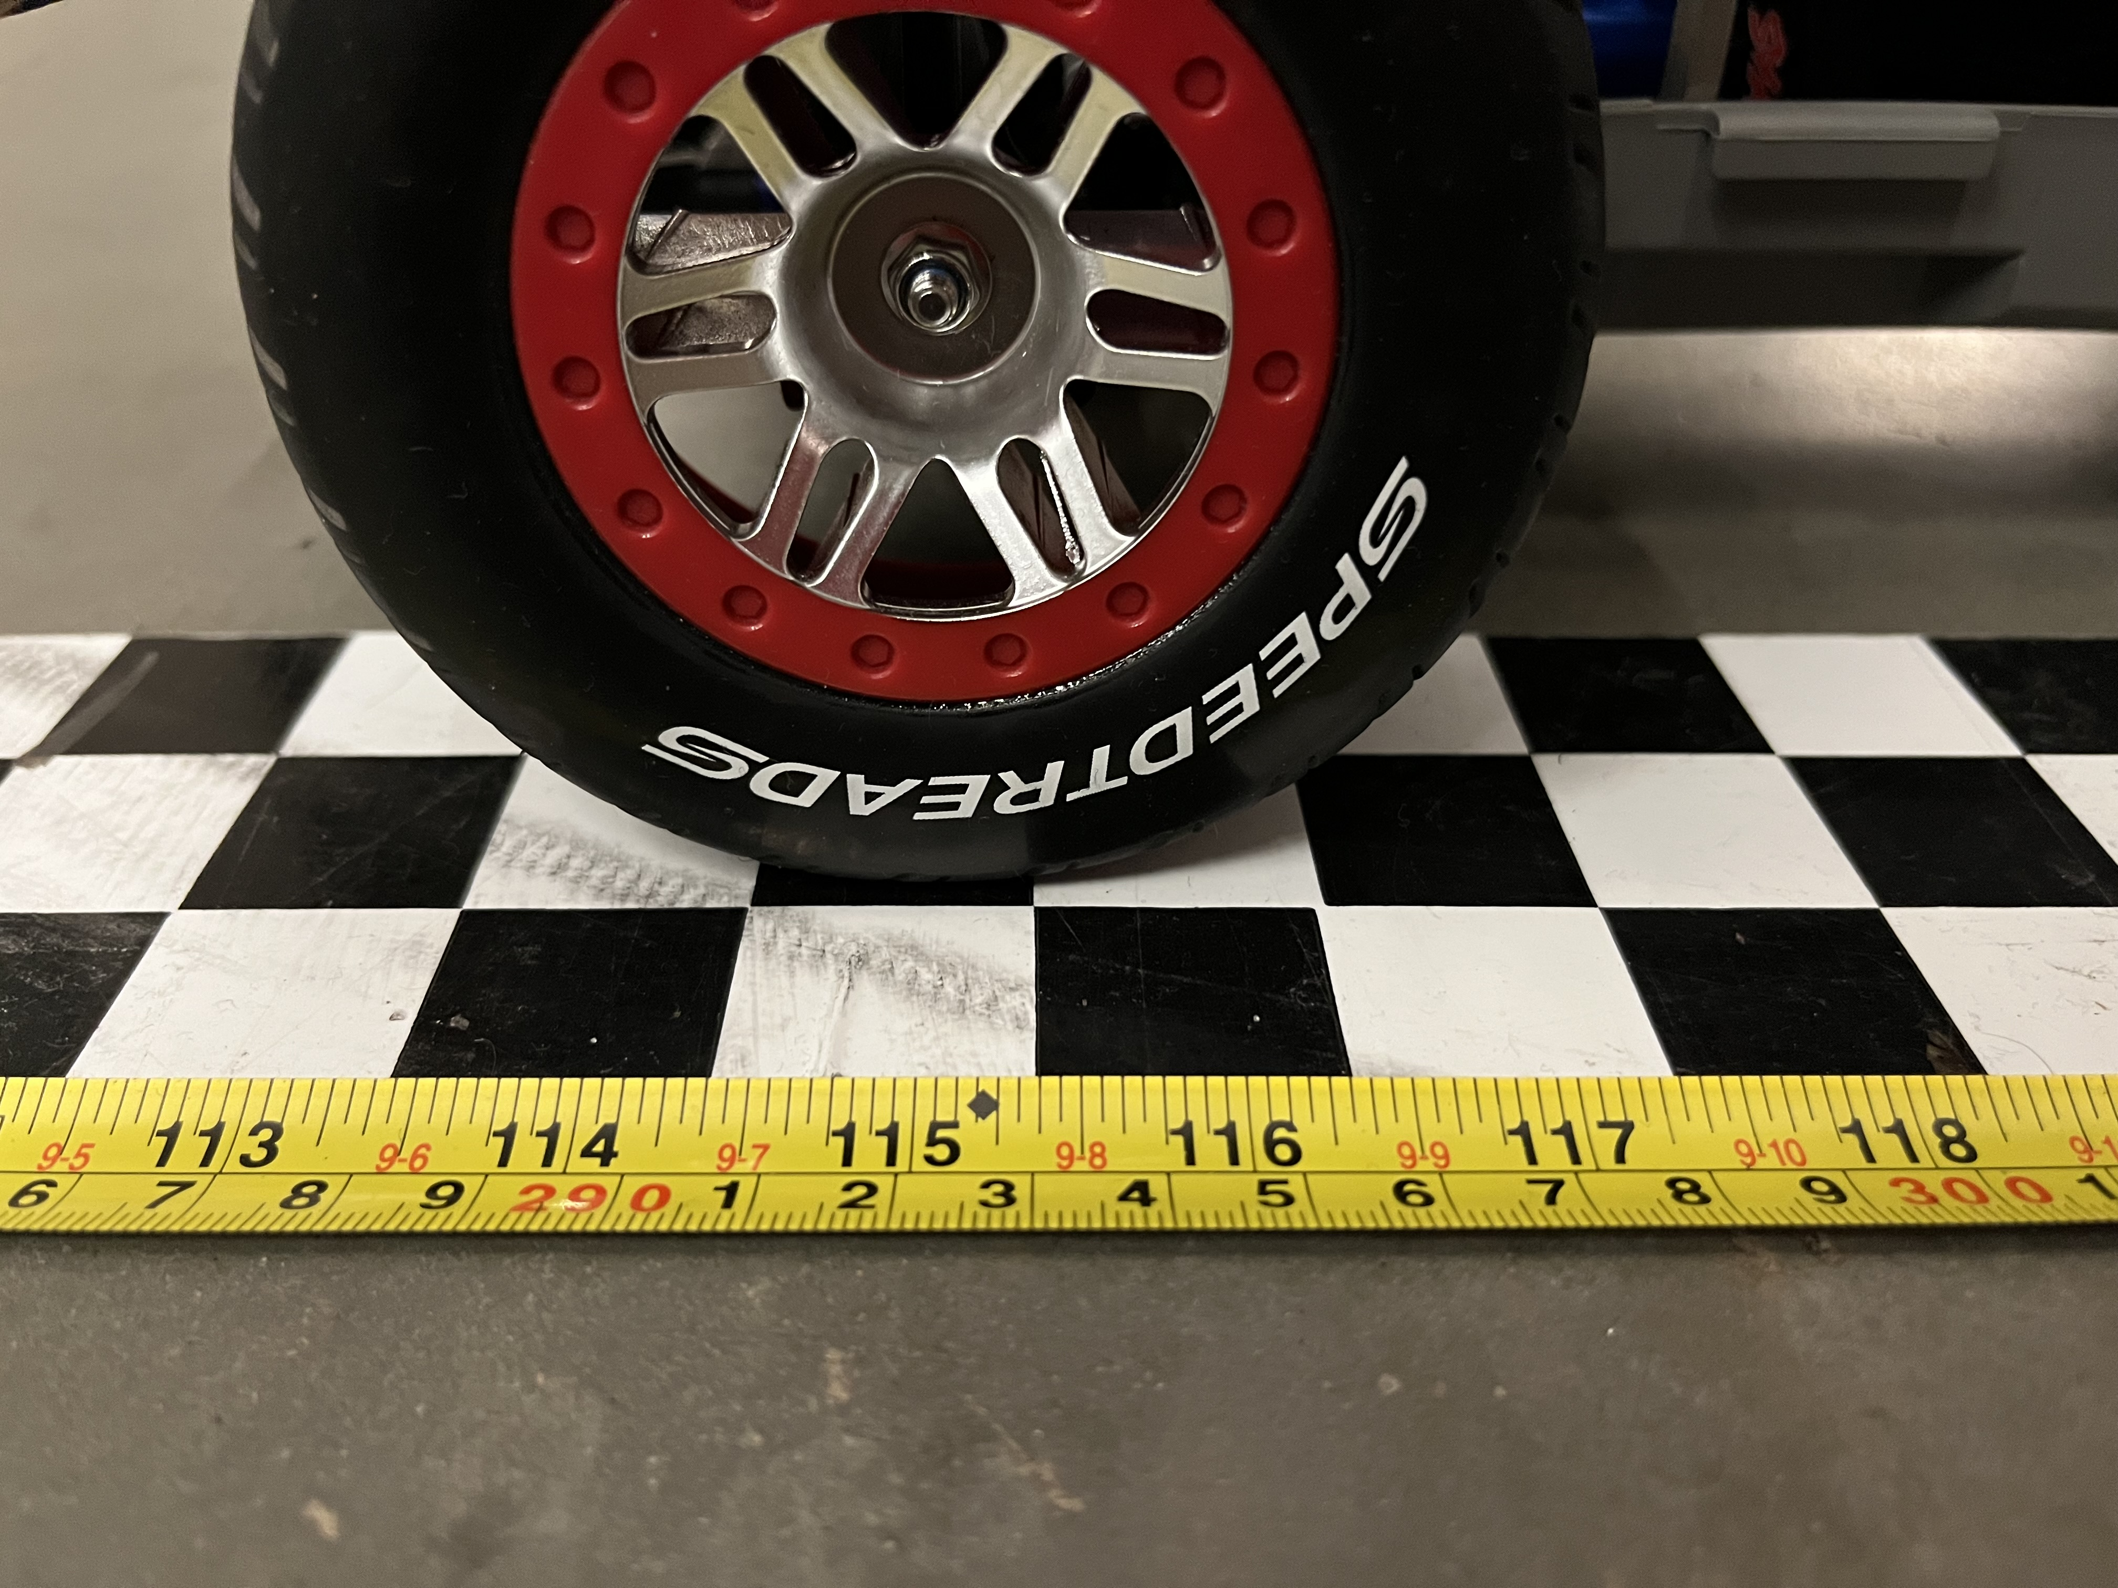
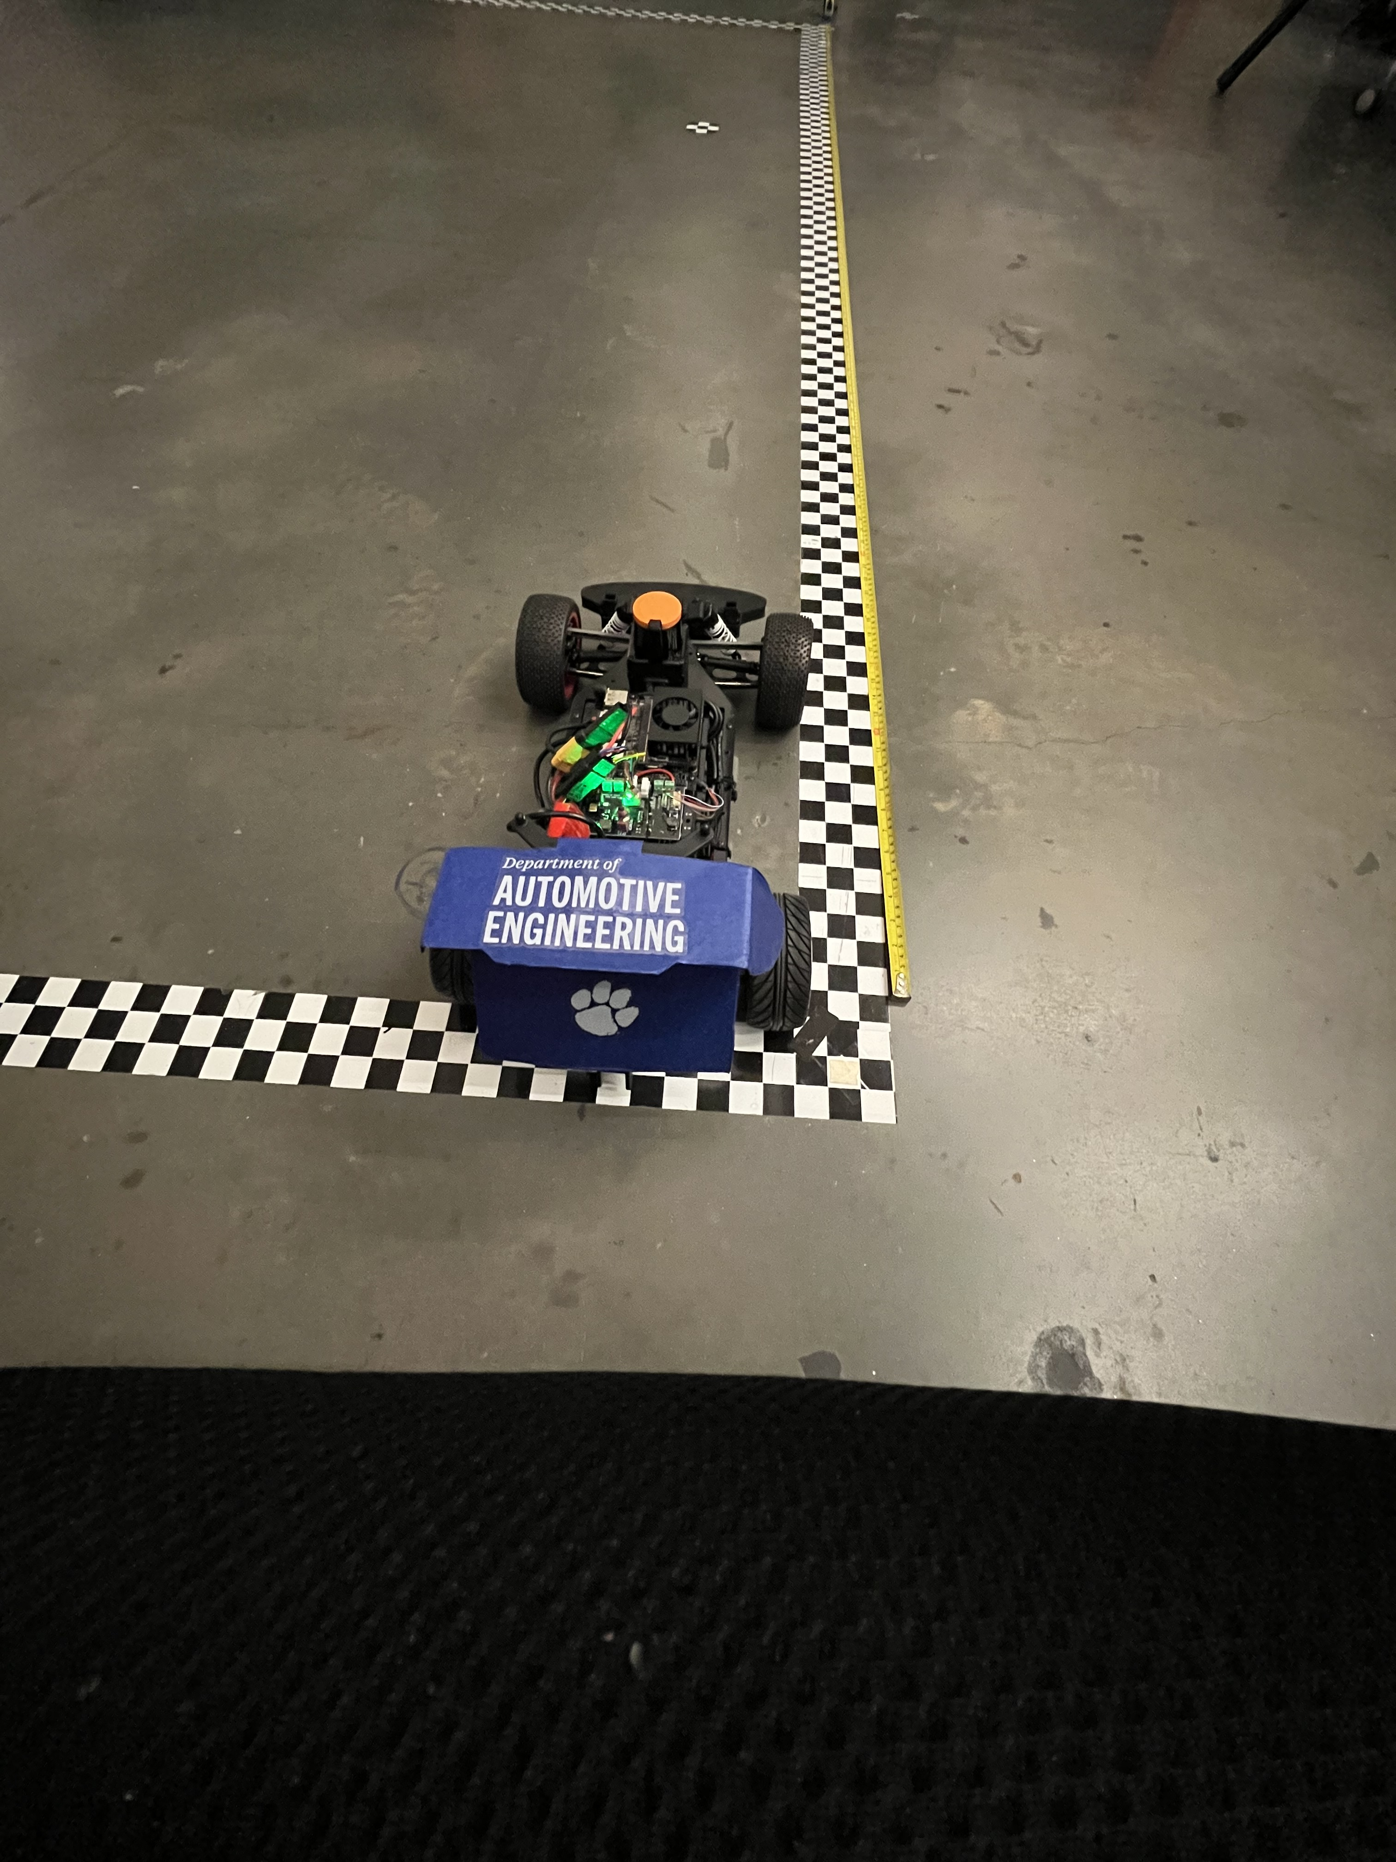
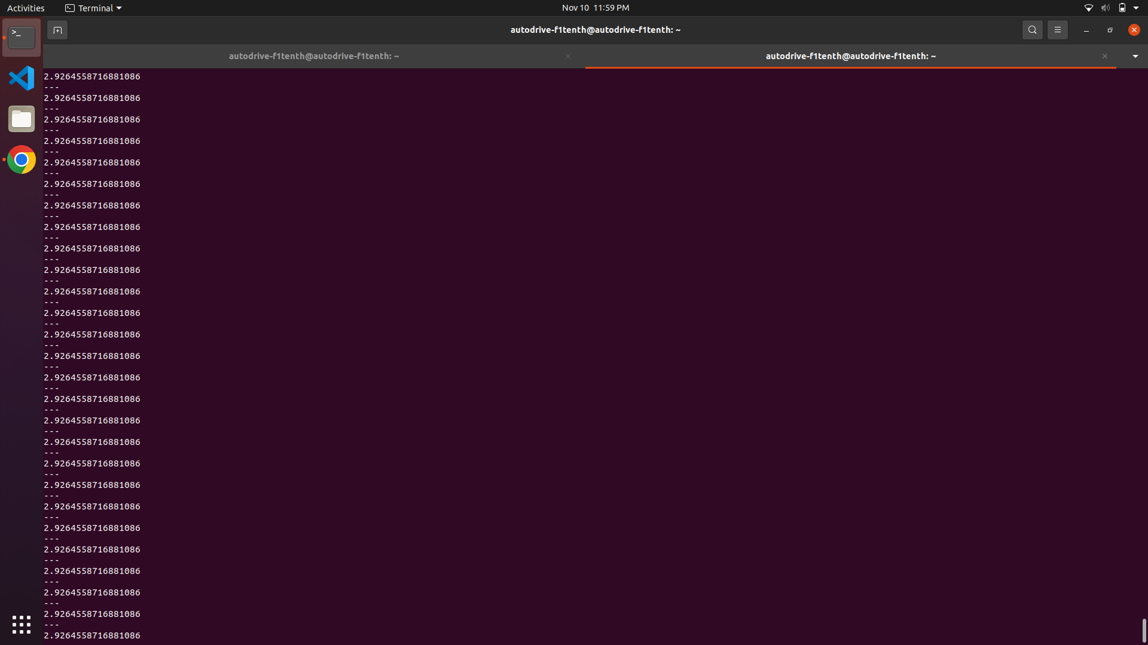
F1TENTH Update Summary
Reflash microSD Card with L4T Ubuntu 20.04
JetPack 5.1.1
Flashing instructions [1] [2]
Configure hardware/software
Install VNC for display forwarding
Install HDMI emulator
Install and configure Logitech F710 module
Hokuyo 10LX network configuration
VESC tuning and configuration
VESC calibration for odometry (steer/drive)
Static udev rules for all peripherals
Before
After

Slide 12
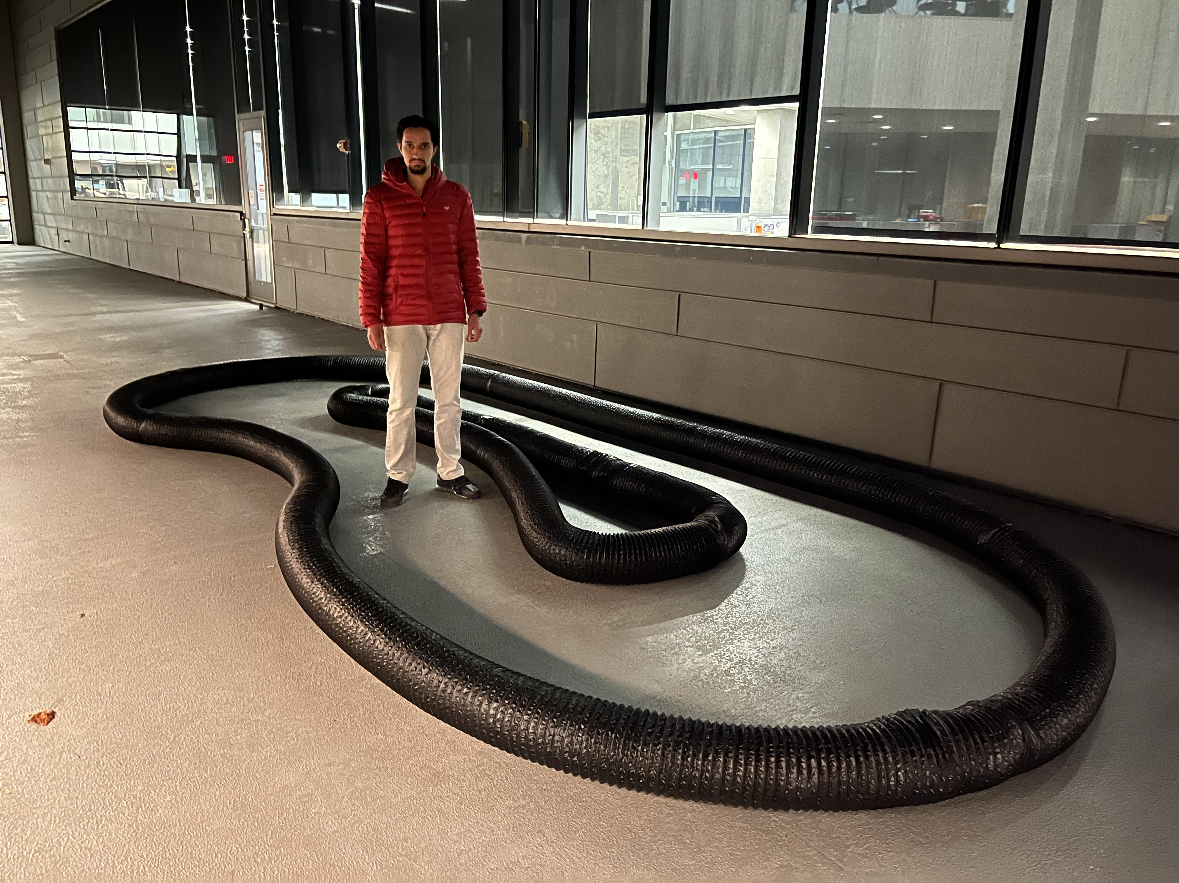
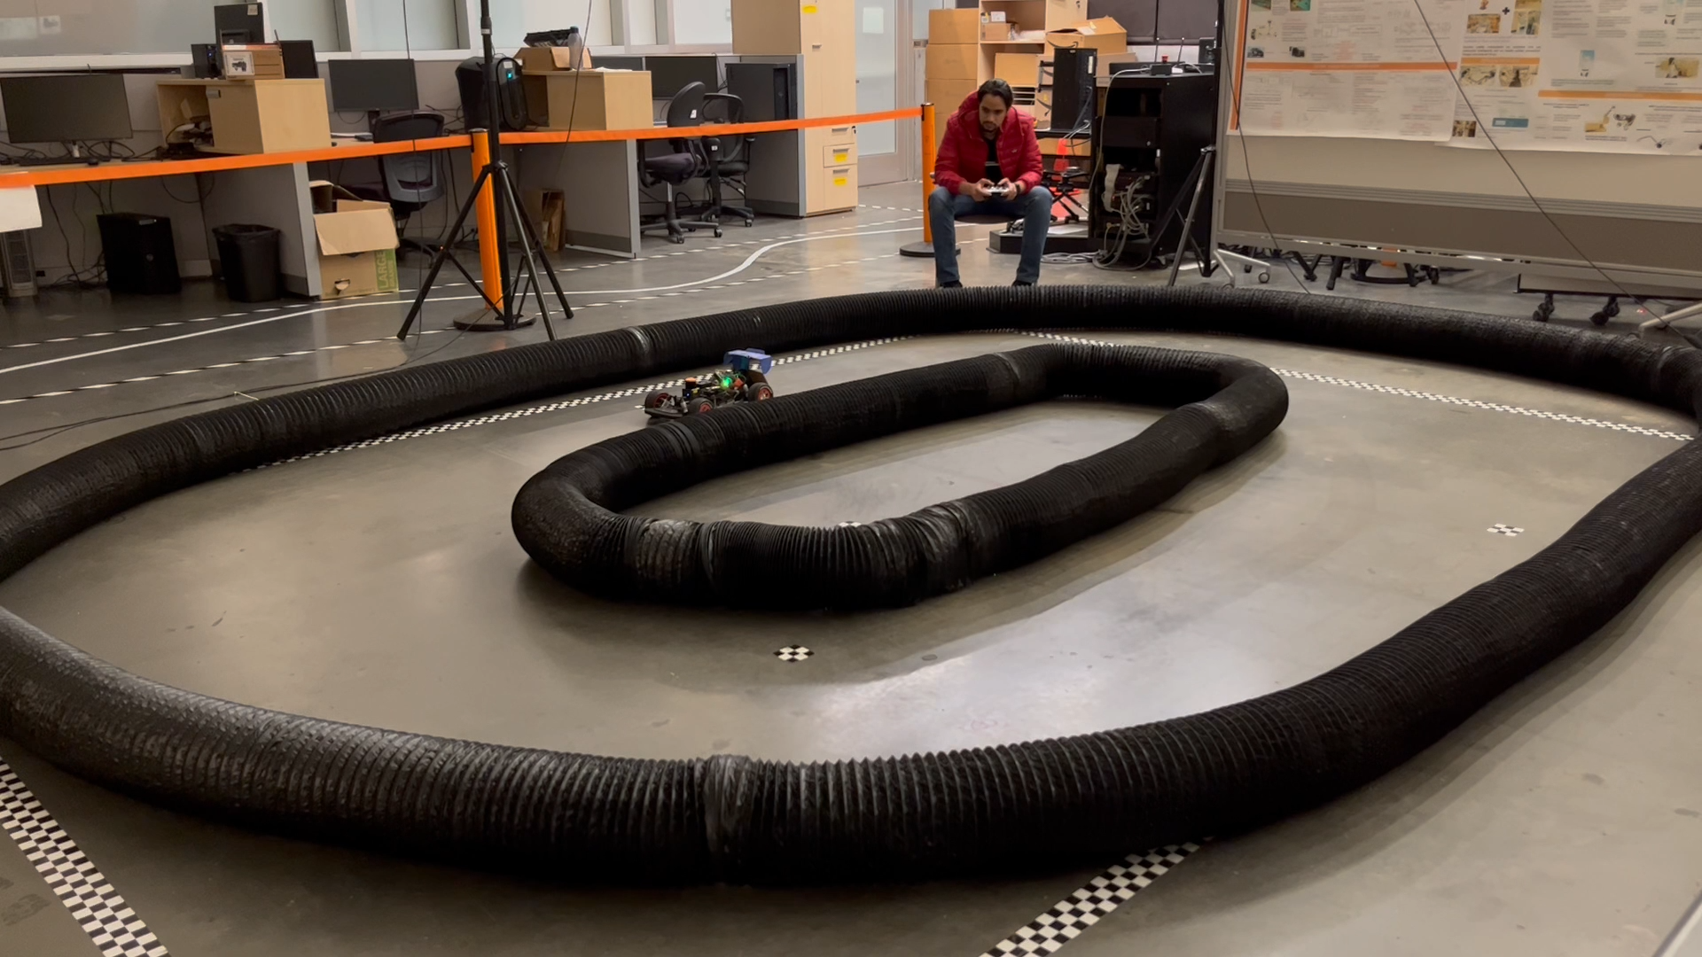
F1TENTH Update Summary
F1TENTH Track Setup
Small track in lab
Course track in terrace

Slide 13
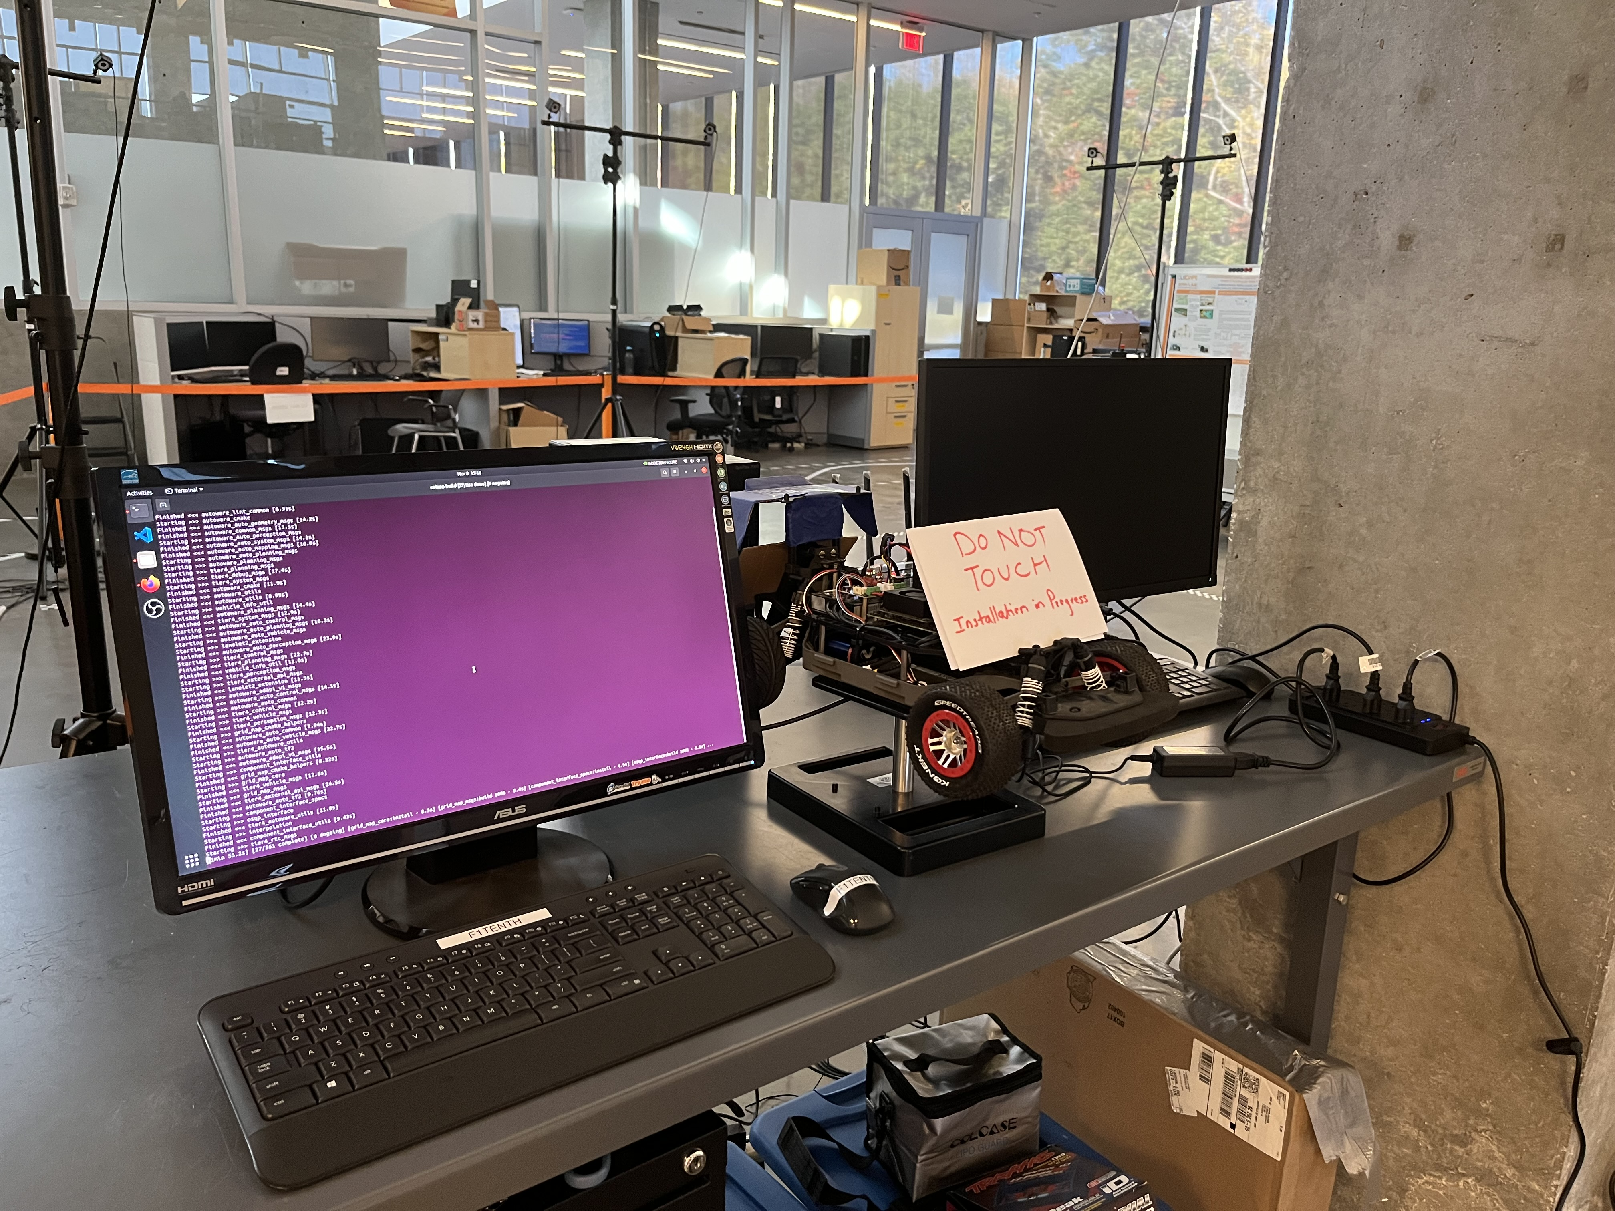
Autoware Update Summary
Compute Platforms
Alienware X15 R2
Jetson Xavier NX
Install Autoware Core/Universe
F1TENTH (local)
Laptop (local+docker)
Stable testing with other ROS & ROS 2 distros installed
F1TENTH (ROS Noetic + ROS 2 Galactic + Autoware Core/Universe)
Laptop (ROS Noetic + ROS 2 Foxy + ROS 2 Galactic + Autoware Core/Universe)
Autoware Messages
Create ROS Package (ROS enabled data-processing for Autoware-powered vehicles)

Slide 14
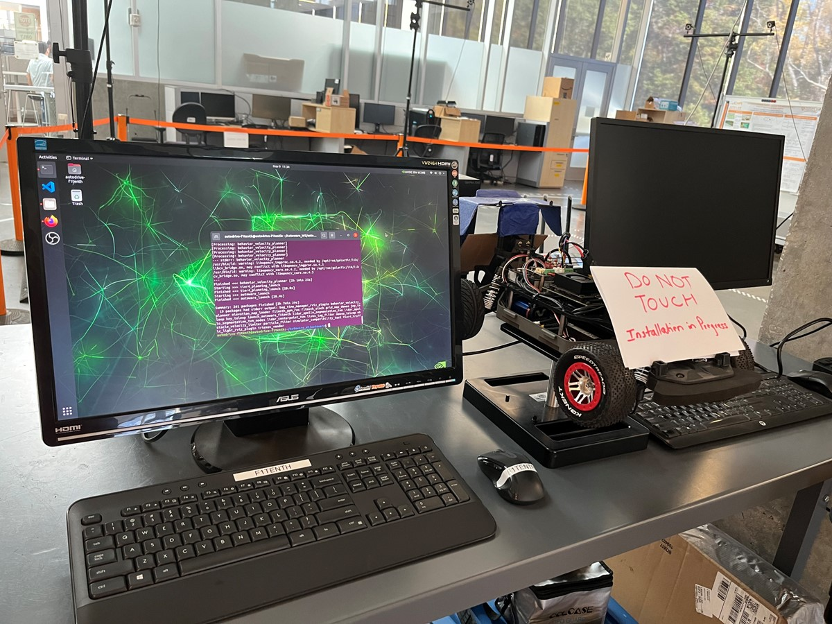
Autoware on F1TENTH
Install Autoware Core/Universe
Install ROS 2 Galactic [Install instructions]
Install ROS Noetic [Install instructions]
Extreme memory requirements (for build)
Build failures due to exceeding memory
Standard errors (ROS DISTROS mismatch)
Include EOL DISTROS for rosdep update
Upgrade to 128 GB microSD Card
64 GB SWAP partition
Extreme build time (>8 hours)
Rebuild select packages (faster)
Caution with ENV variables

Slide 15
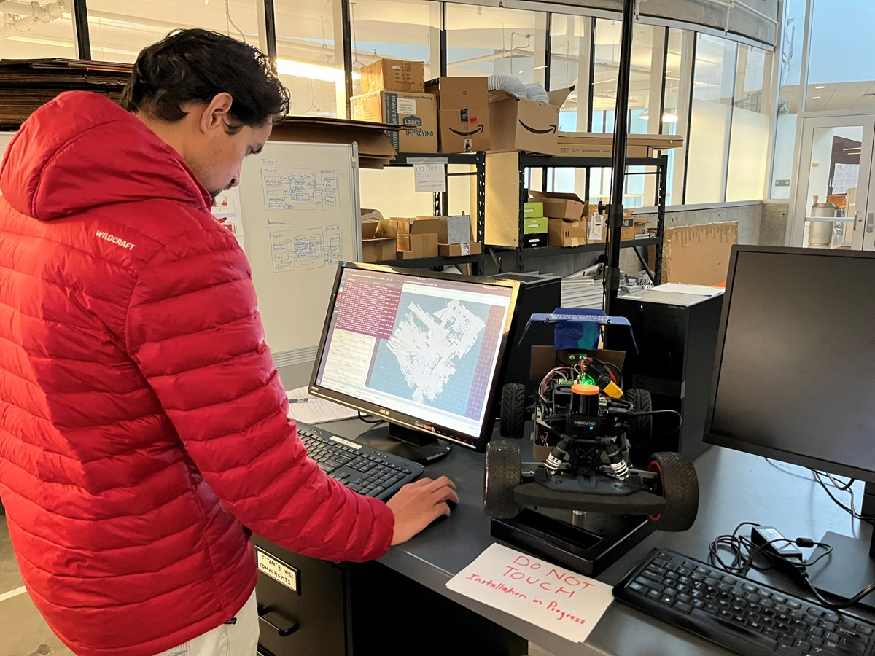
Autoware on F1TENTH
Install Autoware Core/Universe
Backup src and build of Autoware_WS
Cloning microSD Card is recommended
Autoware demo
Test all packages
SLAM + Record + Replay
RViz Sim + Real F1TENTH

Slide 16
References
T. Samak, C. Samak, S. Kandhasamy, V. Krovi, and M. Xie, “AutoDRIVE: A Comprehensive, Flexible and Integrated Digital Twin Ecosystem for Autonomous Driving Research & Education,” Robotics, vol. 12, no. 3, p. 77, May 2023, doi: 10.3390/robotics12030077
W. Ding, C. Xu, M. Arief, H. Lin, B. Li and D. Zhao, “A Survey on Safety-Critical Driving Scenario Generation—A Methodological Perspective,” in IEEE Transactions on Intelligent Transportation Systems, vol. 24, no. 7, pp. 6971-6988, July 2023, doi: 10.1109/TITS.2023.3259322
M. Quigley, K. Conley, B. Gerkey, J. Faust, T. Foote, J. Leibs, R. Wheeler, and A. Ng, “ROS: an open-source Robot Operating System,” in ICRA 2009 Workshop on Open Source Software, vol. 3, Jan 2009. [Online]. Available: http://robotics.stanford.edu/~ang/papers/icraoss09-ROS.pdf
S. Macenski, T. Foote, B. Gerkey, C. Lalancette, and W. Woodall, “Robot operating system 2: Design, architecture, and uses in the wild,” Science Robotics, vol. 7, no. 66, p. eabm6074, 2022. [Online]. Available: https://www.science.org/doi/abs/10.1126/scirobotics.abm6074
Autoware Foundation, “Autoware Project: The world’s leading open-source software project for autonomous driving.” [Online]. Available: https://autoware.org

